Slide 1

Meet the Teacher:
Ash Class

Slide 2
Aims
Curriculum – what your child will learn this year
How you can help at home
Assessment – how we will assess what they know and what we will do to support
Enrichment – the fun activities we have planned to enhance our curriculum offer
Questions

Slide 3
Ash Class teaching structure
Miss Cutler – Monday, Tuesday and Wednesday morning.
Mrs Poole – Wednesday afternoon, Thursday and Friday.
Supported all week by Mrs Brandt.

Slide 4
Ash Class timetable
 | Monday | Tuesday | Wednesday | Thursday | Friday
8.45-9.00 | Gross and fine motor activity | Gross and fine motor activity | Gross and fine motor activity | Gross and fine motor activity | Gross and fine motor activity
9.00-9.30 | Phonics | Phonics | Phonics | Phonics | Celebration assembly
9.30-10.15 | Provision | Provision | Provision | Provision | Provision
10.15-10.30 | Social Snack time Brain break | Social Snack time Brain break | Social Snack time Brain break | Social Snack time Brain break | Social Snack time Brain break
10.30-10.45 | Drawing Club Input | Drawing Club Input | Drawing Club Input | Drawing Club Input | Phonics
10.45-11.15 | Provision Drawing Club groups | Provision Drawing Club groups | Provision Drawing Club groups | Provision Drawing Club groups | Provision Drawing Club groups
11.15-11.45 | Little Wandle reading groups | Little Wandle reading groups | Little Wandle reading groups | Little Wandle reading groups | Little Wandle reading groups
11.45-11.55 | Handwriting | Handwriting | Handwriting | Handwriting | Handwriting
12.00-1.00 | Lunch | Lunch | Lunch
1.00-1.20 | Register Maths input | Register Maths input | Register Maths input | Register Maths input | Register Maths input
1.20-1.45 | Focused provision | Focused provision | Focused provision | Focused provision | Focused provision
1.45-3.00 | Provision P.E | Provision Understanding of the World/PSHE | Provision Understanding of the World | Provision Understanding of the World/Expressive arts and design | Provision P.E/Forest School Library
3.00 | Story time Rhyme time | Story time Rhyme time | Story time Rhyme time | Story time Rhyme time | Story time Rhyme time
3.20 | Getting ready for home | Getting ready for home | Getting ready for home | Getting ready for home | Getting ready for home
3.30 | Dismissal | Dismissal | Dismissal | Dismissal | Dismissal

Slide 5
Curriculum
 | Autumn 1 | Autumn 2 | Spring 1 | Spring 2 | Summer 1 | Summer 2
Reading | Little Wandle Phonics – see separate handout | Little Wandle Phonics– see separate handout | Little Wandle Phonics– see separate handout | Little Wandle Phonics– see separate handout | Little Wandle Phonics– see separate handout | Little Wandle Phonics– see separate handout
Writing | Drawing Club | Drawing Club | Drawing Club | Drawing Club | Drawing Club | Drawing Club
Handwriting | Unit 1- practising patterns | Unit 2- Curly letter family Unit 3- Long letter family | Unit 4- bouncy letter family Unit 5- zig zag letter family | Unit 6- Capital letters | Unit 6- Capital letters- contd Unit 7- Digraphs and Trigraphs | Unit 7- Digraphs and Trigraphs- contd
Maths | White Rose Maths – see separate hand out | White Rose Maths – see separate hand out | White Rose Maths – see separate hand out | White Rose Maths – see separate hand out | White Rose Maths – see separate hand out | White Rose Maths – see separate hand out
Understanding of the World The Natural World | Seasons | Light and Dark- nocturnal animals Seasons Artic/Antarctica | Our environment/our local environment Seasons | Seasons Planting/gardening | Seasons Lifecycles Habitats | Seasons Farm animals Food from farms Farming around the world
Understanding of the World People and Communities | Me and my family Diwali Day Harvest festival | Christmas | Chinese New Year Mother’s Day Mapping | Shrove Tuesday Easter | Eid St George’s Day | Father’s day Farmers
Understanding of the World Past and Present | Me and my family How I’ve changed | Guy Fawkes | Our Environment |  | Farming in the past
PSHE | Self regulating, listening and following instructions | Self regulation – my feelings | Building Relationships – My family and Friends | Building Relationships – Special relationships | Managing Self – My wellbeing | Managing Self – Taking on Challenges
Expressive Arts and Design Creating with materials | Drawing- controlled lines when drawing Shades- lighter and darker Self portaraits Diwali crafts Christmas crafts |  | Painting/Colour mixing Printing- printing repeating patterns- flowers and food Sculpture and box modelling |  | Natural collage- transient art Clay
Expressive Arts and Design Being imaginative and expressive | Experimenting with sounds Nursery Rhymes and action songs | Christmas Nativity Songs | Singing well known Nursery Rhymes Exploring Instruments | Experimenting with pitch/dynamics | Experimenting with instruments | Exploring Composition
Computing | Technology in Toys |  | Using Technology for a Purpose |  | Basics of Coding
Physical Development Gross Motor | Fundamental movement skills Yoga Gross motor alphabet activities | Gymnastics 1- floor based Dance 1- short stories and animals | Gymnastics 2- apparatus Ball skills 1 | Ball skills Unit 2 Athletics | Athletics | Consolidation
Physical Development Fine Motor | Develop arm/hand/finger strength and pincer grip Pencil grip Gross motor mark making Dance ribbons Mark making- pre writing shapes Mark making- messy play Tweezer activities Scissors with playdough Lacing cards/threading activities Dot marker art- bingo dabbers/finger painting Sicker art Pipettes Bubble wrap Using a knife and fork in the lunch hall Simple clothing fastenings Building a tower/model using larger construction- duplo Using pegs- large |  | Develop pincer grip, finger strength, control Hammer shapes Nuts and bolts Cotton bud printing Pegs and peg boards/geo boards Cutting skills- cooking Pencil control- shapes/letter formation/numbers Scissors- cutting lines and simple shapes Managing fastenings Hole punch activities Building a tower/model using larger construction- duplo/lego Using pegs- small |  | Secure, effective pencil grip, good pencil control and confident use of tools including scissors Dot to dot challenges Handwriting Smaller sticker activities Tweezer activities Building a tower/model using larger contruction- lego

Slide 6
How you can help at home
Supporting your child with reading at home
Weekly phonics homework
Independence skills
Talk and listen
Be patient they will be tired!

Slide 7

Assessment
Reception Baseline Assessment – First 6 weeks
Half Termly Phonic Assessments
Tapestry
Teacher Assessments
Summer 2026 – Foundation Stage Profile
Progress will be shared at parents evenings.

Slide 8
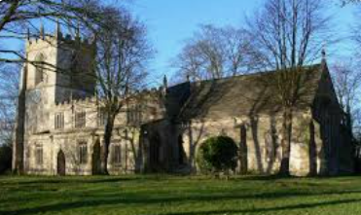
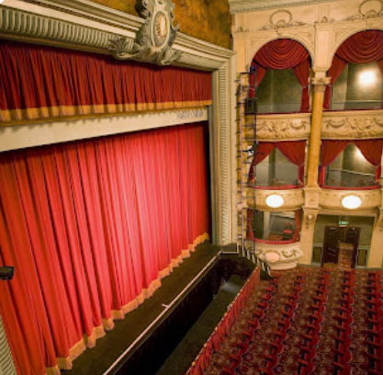

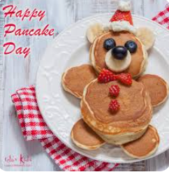

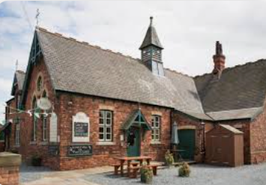
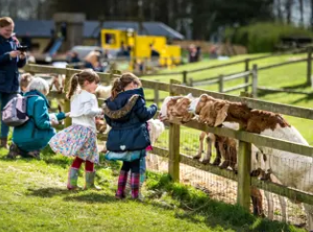

Enrichment
Autumn- Harvest festival at Bubwith Church, Diwali Day- visitor/workshops in school, Christingle at Bubwith Church, walks around our school grounds, visit to the pantomime in York.
Spring- Chinese New Year activities, Pancake Day, visit to the a farm, walks and visits to places in our local community- post office/Jug and Bottle. Growing food- Elmswell Farm
Summer- Visits linked to our Minibeasts and Farming- Castle Howard Arboretum.

Slide 9
Questions

