Slide 1

Meet the Teacher:
Beech Class
Miss Shimells

Slide 2
Aims
Curriculum – what your child will learn this year
How you can help at home
Assessment – how we will assess what they know and what we will do to support
Enrichment – the fun activities we have planned to enhance our curriculum offer
Questions

Slide 3
Curriculum
Please see handout
Notes:
Curriculum map for the year group (in handout)
Highlight key units over the course of the year and what these will include
Share the PSHE overview and how this will be taught
Give more detail about this half term’s units and learning

Slide 4
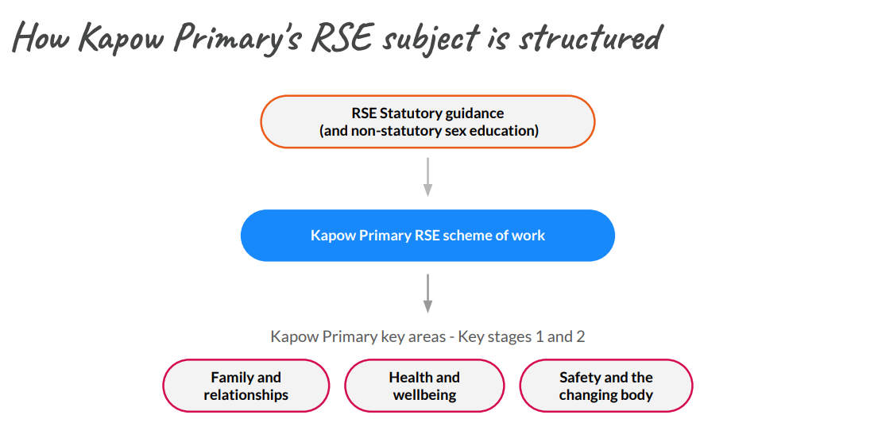
PSHE
As the DFE guidance has changed this year, we are reviewing our RSE policy so a consultation for parents and carers to consider and respond to will be sent out on Friday 25th September 2026.

Slide 5
How you can help at home
Regular reading
Common Exception Words
Times Tables practice
  https://www.topmarks.co.uk/maths-games/hit-the-button
  https://www.timestables.co.uk/
  Times Tables Rockstars
Notes:
Overview of homework or home learning expectations
Apps and websites that parents can use (e.g. TTRS)
Core skills that parents can practise with their children at home (e.g. home reader, times tables)
Insert any videos or resources that might help (in handout)

Slide 6
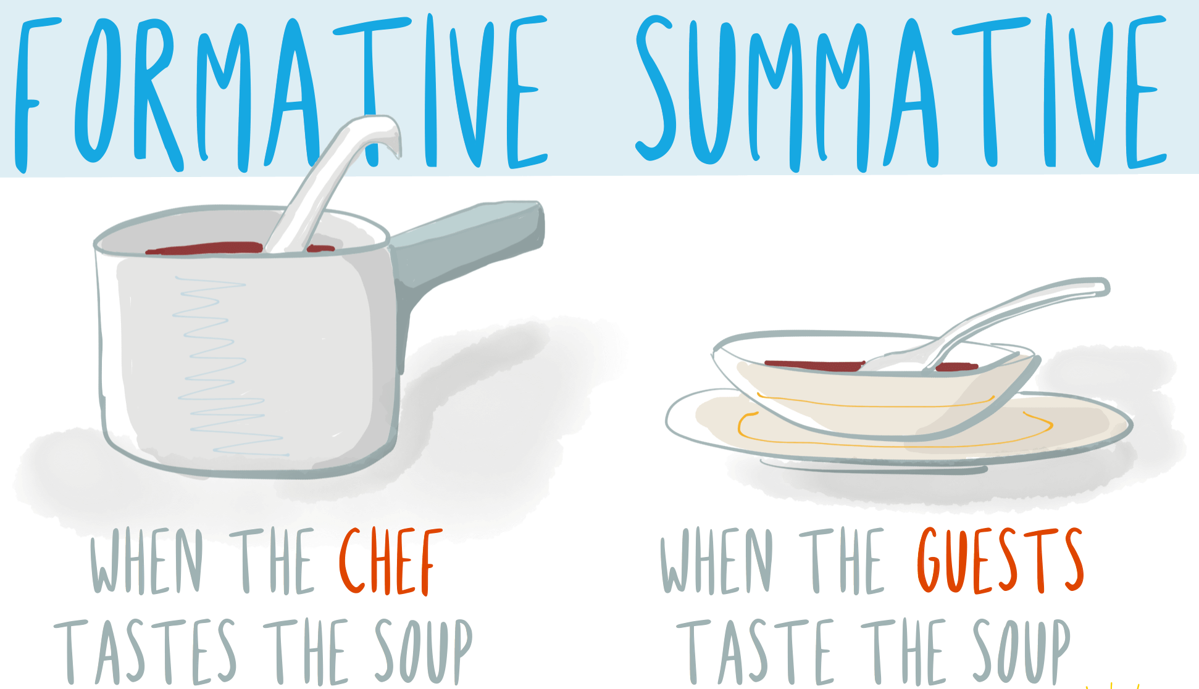
Assessment: internal
Daily:
Marking/Feedback
Asking questions
Interventions
Lesson quizzes
Termly:
Reading assessment
Maths assessment
Writing teacher judgement
Progress updates are shared in parents’ evenings or on the door.

Slide 7
Assessment
Statutory assessment – Y4 Multiplication Check June 2026
  https://www.gov.uk/government/collections/multiplication-tables-check
Ongoing assessment
  End of unit assessments (White Rose, CUSP)
  Regular writing checks
Notes:
Overview of in-school assessment points and what these look like
Information about any statutory assessments during the year including dates of assessments, what is assessed and how parents will find out results
Show a sample of the statutory assessment and give out any DFE parent leaflets (in handout)

Slide 8
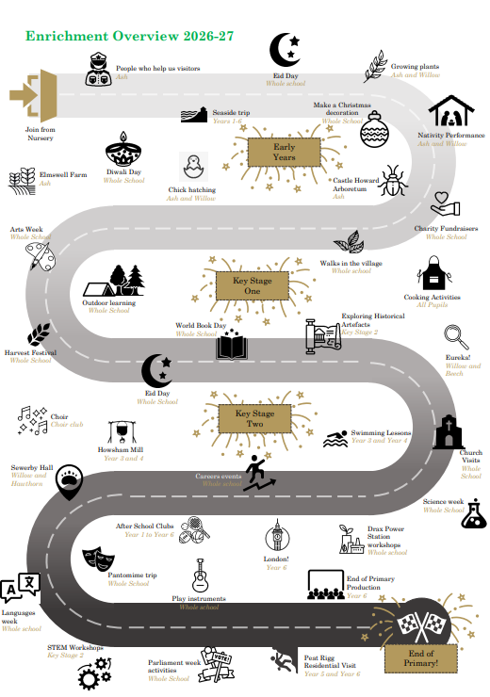
Enrichment

Slide 9
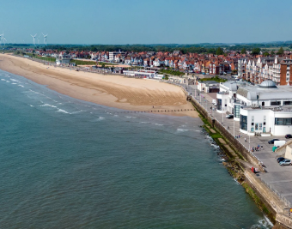
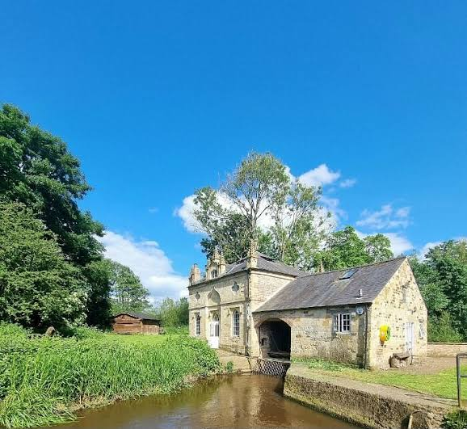

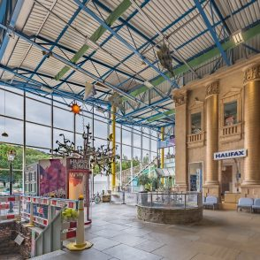
Trips this year
East Yorkshire Coast
29th /30th September
Howsham Mill
5th November
York Grand Opera Pantomime
17th December
Eureka!
10th March

Slide 10
Questions

