Slide 1
Meet the Teacher:
Hawthorn

Slide 2
Aims
Curriculum – what your child will learn this year
How you can help at home
Assessment – how we will assess what they know and what we will do to support
Enrichment – the fun activities we have planned to enhance our curriculum offer
Questions

Slide 3
Curriculum
Curriculum map for the year group (in handout)
In the handout you will find the long term plan for the entire year. This shows all the topics that we will cover throughout the year.
The PSHE overview is on the KAPOW primary website in the parent zone. I will display this now.
At end of this presentation I will give you time to read these through and allow enough time for any questions.

Slide 4

Assessment: internal
Daily:
Marking/Feedback
Asking questions
Interventions
Lesson quizzes
Termly:
Phonics assessment*
Reading assessment
Maths assessment
Writing teacher judgement
Progress updates are shared in parents’ evenings or on the door/over the phone.

Slide 5
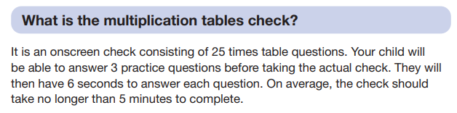
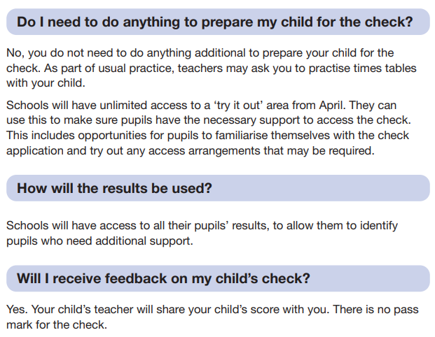
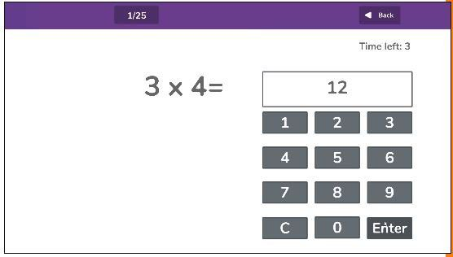
Statutory Assessments: Multiplication Tables Check

Slide 6
How you can help at home
Each Monday, your child will receive some spellings homework which will be due in on Friday.
Apps and websites: Year 4s will be completing their times tables check in spring term so must be practicing their times tables as much as they can. Apps/websites such as TTRS and hit the button are excellent and helping to consolidate their learning.
Year 5s must also be practicing these skills to ensure they stay sharp in their heads in preparation for SATs next year.
It is also helpful to be reading with your child each week. This not only helps their fluency but also their writing skills will improve too.

Slide 7
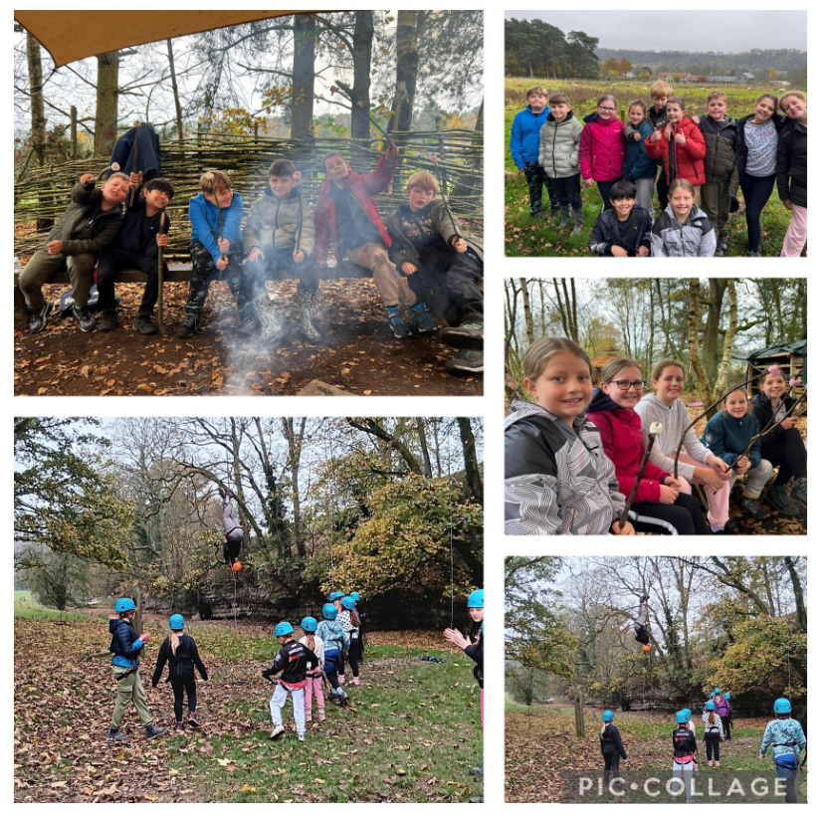
Enrichment
Share whole school enrichment overview
Peat Rigg (5 and 6)
Sewerby Hall
Pantomime
Languages week
Art week
Plus lots of other exciting opportunities

Slide 8


You now have chance to read through any of the information I have given to you and ask any questions you may have.

