Slide 1

Meet the Teacher:
Oak

Slide 2
Aims
Curriculum – what your child will learn this year
How you can help at home
Assessment – how we will assess what they know and what we will do to support
Enrichment – the fun activities we have planned to enhance our curriculum offer
Questions

Slide 3
Year 6 Teaching Structure
Monday-Wednesday: Miss Smith
Thursday and Friday mornings: Miss Walker
Thursday and Friday afternoons: Miss Hughes
Support from Mrs Douglas throughout the week

Slide 4
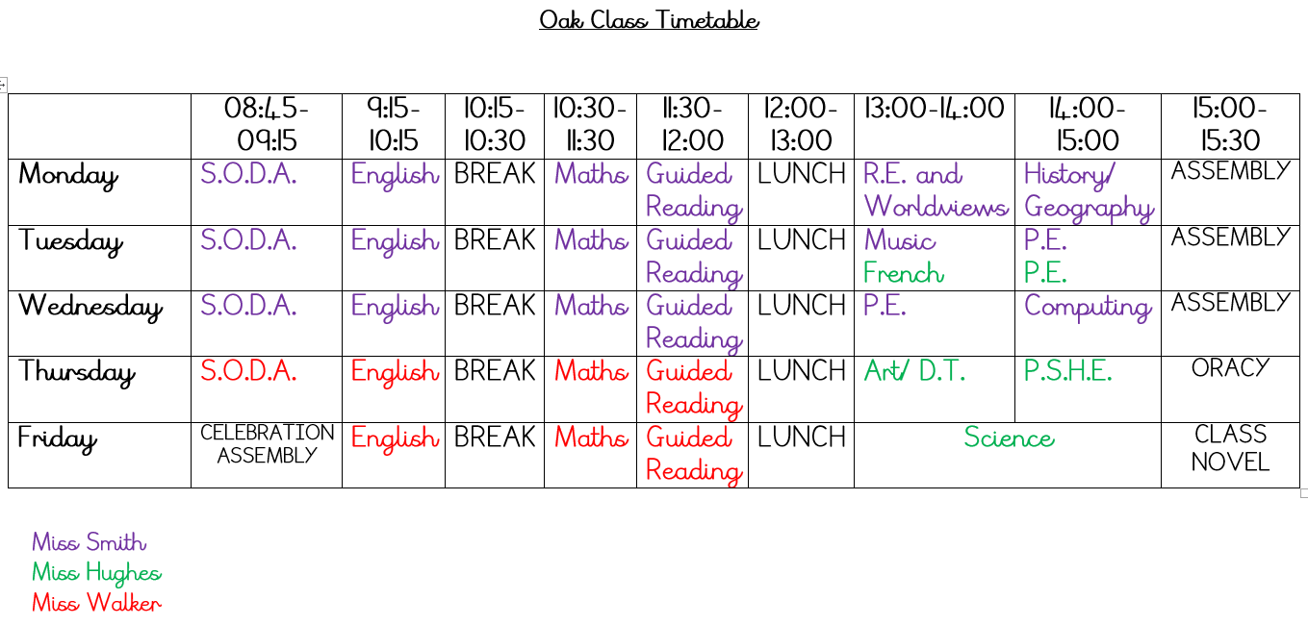

Slide 5
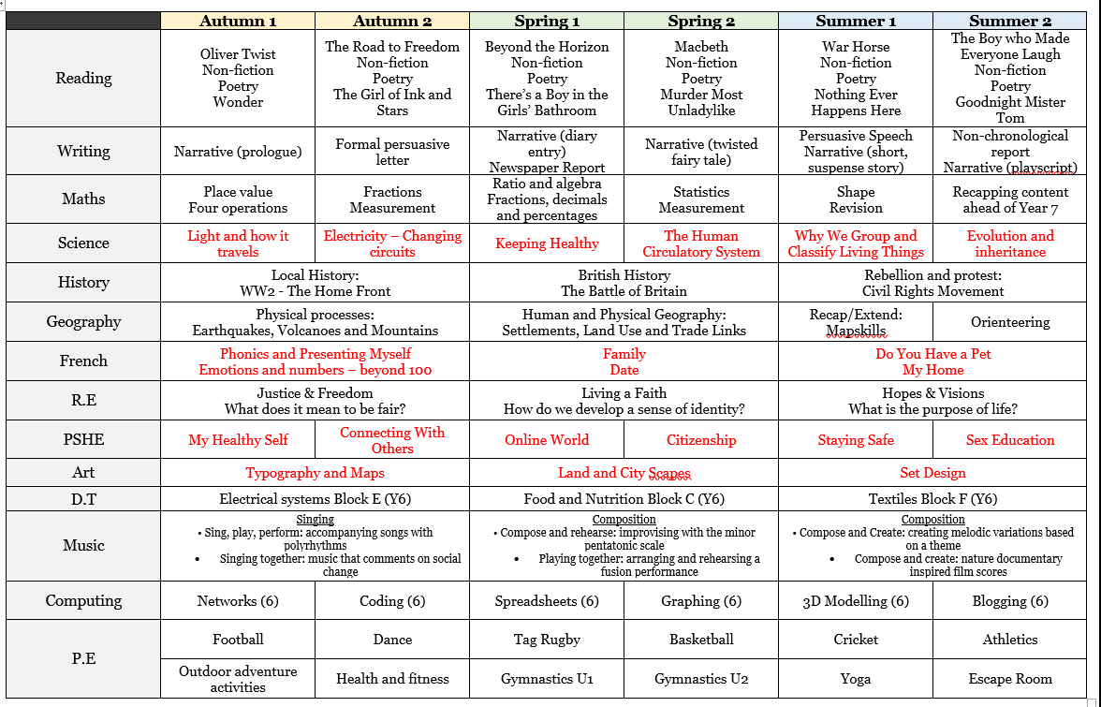
Year 6 Curriculum

Slide 6


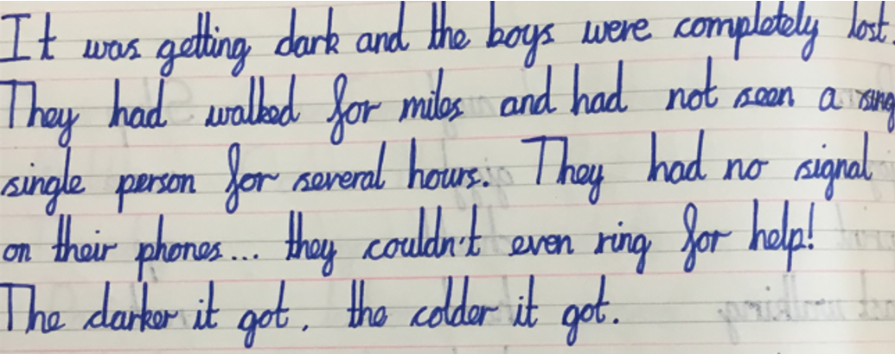

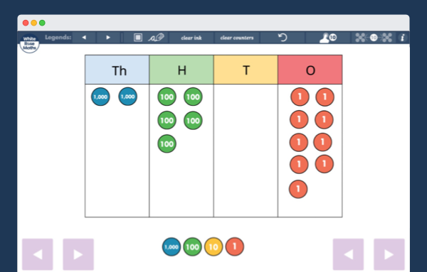
This half term:
Focus on presentation and transcription
Light
Physical processes
Fundamentals of Maths: place value and four operations

Slide 7
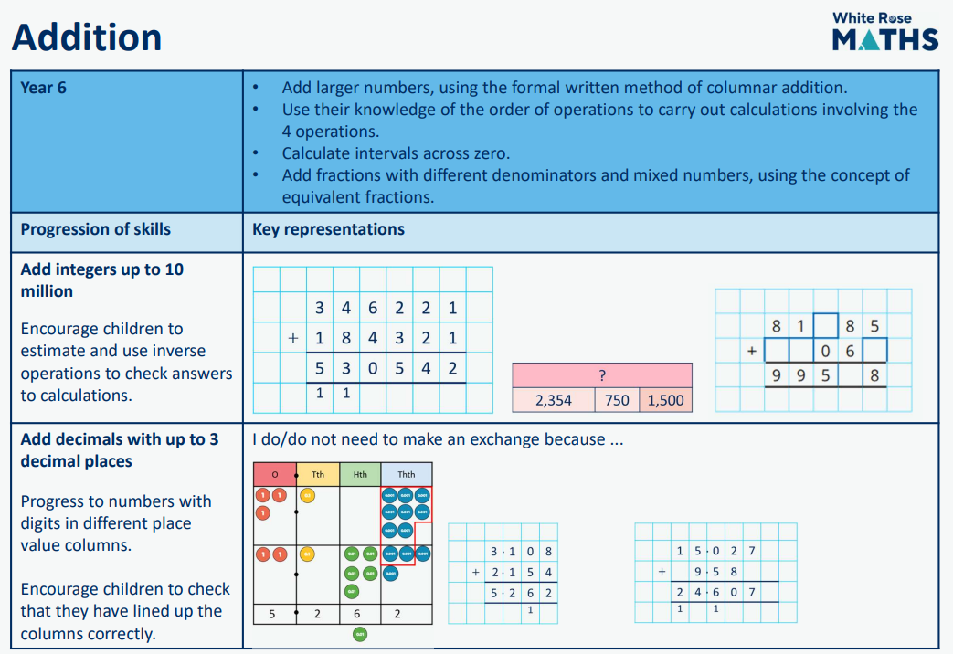
Maths calculation policy example

Slide 8
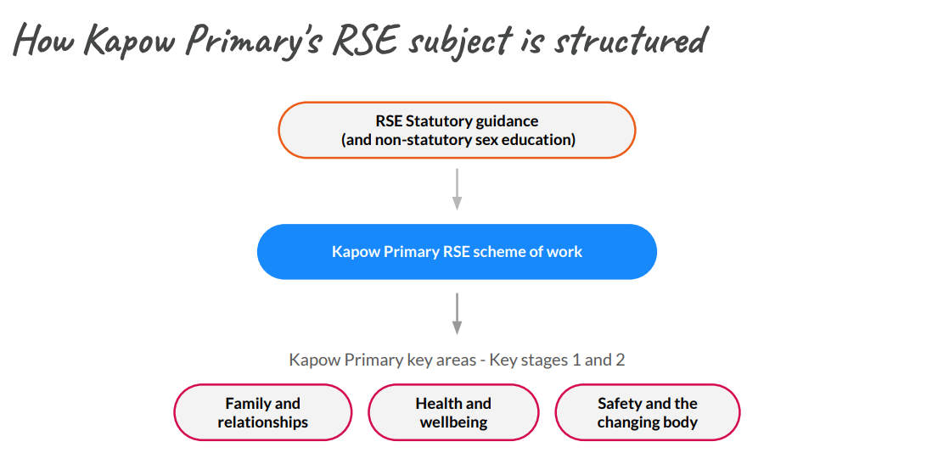
PSHE
As the DFE guidance has changed this year, we are reviewing our RSE policy so a consultation for parents and carers to consider and respond to will be sent out on Friday 25th September 2026.

Slide 9
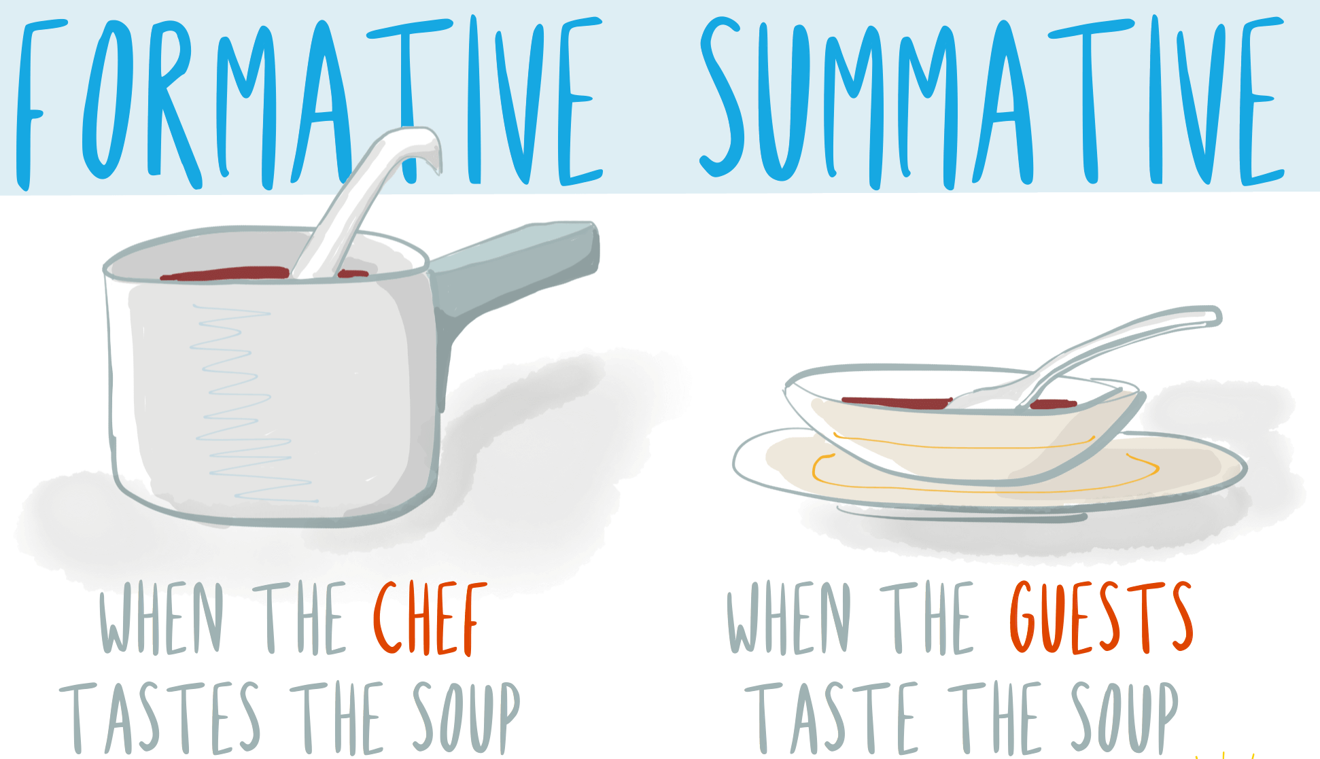
Assessment: internal
Daily:
Marking/Feedback
Asking questions
Interventions
Lesson quizzes
Termly:
Reading assessment
Maths assessment
Writing teacher judgement
Progress updates are shared in parents’ evenings or on the door/over the phone.

Slide 10
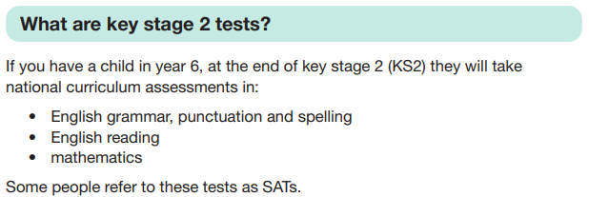
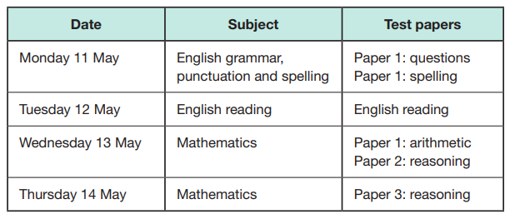
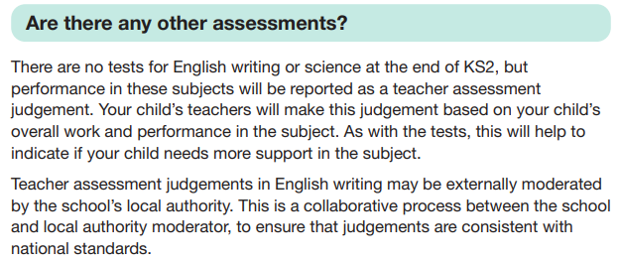
Statutory Assessments: SATs
Monday 10 May
Tuesday 11 May
Wednesday 12 May
Thursday 13 May
Writing deadline is not until June 25th – please refrain from taking your child on holiday before then!

Slide 11
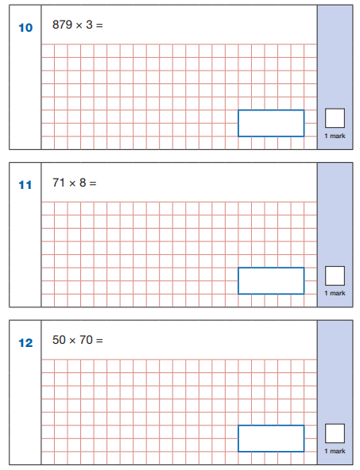

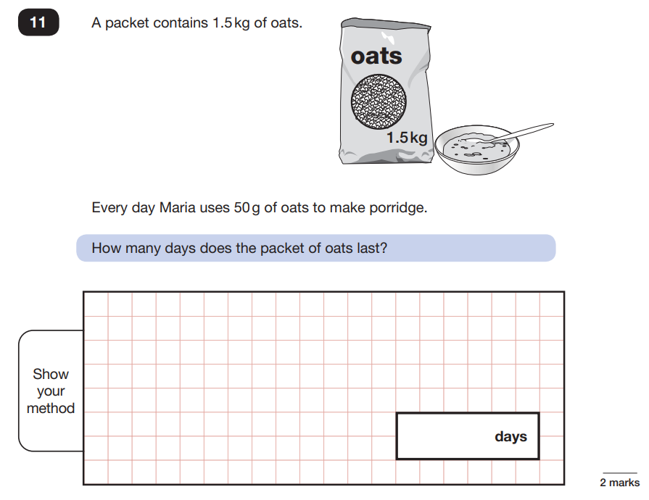
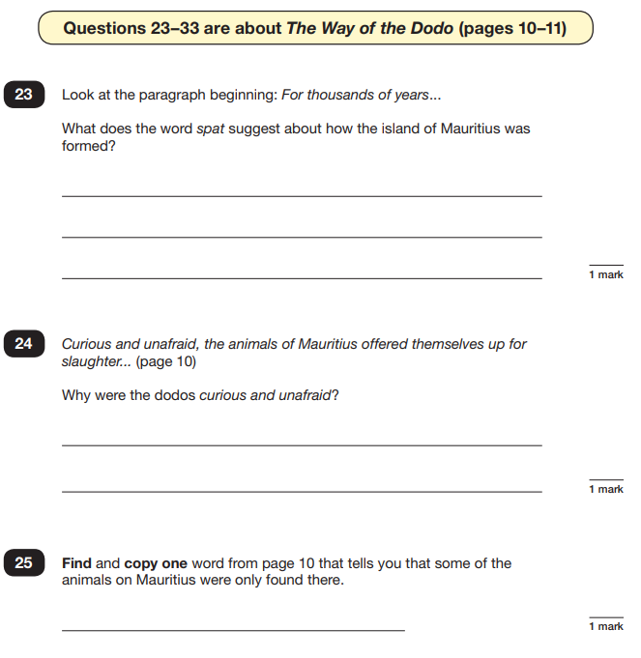
Statutory Assessments: SATs

Slide 12



How you can help at home
Sleep
Read daily
Attendance

Slide 13
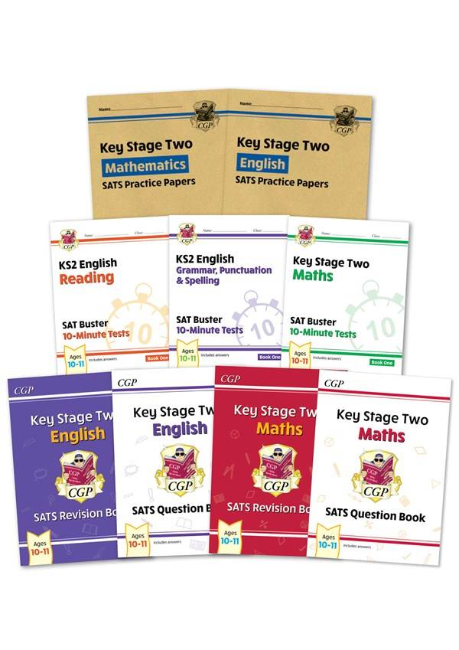
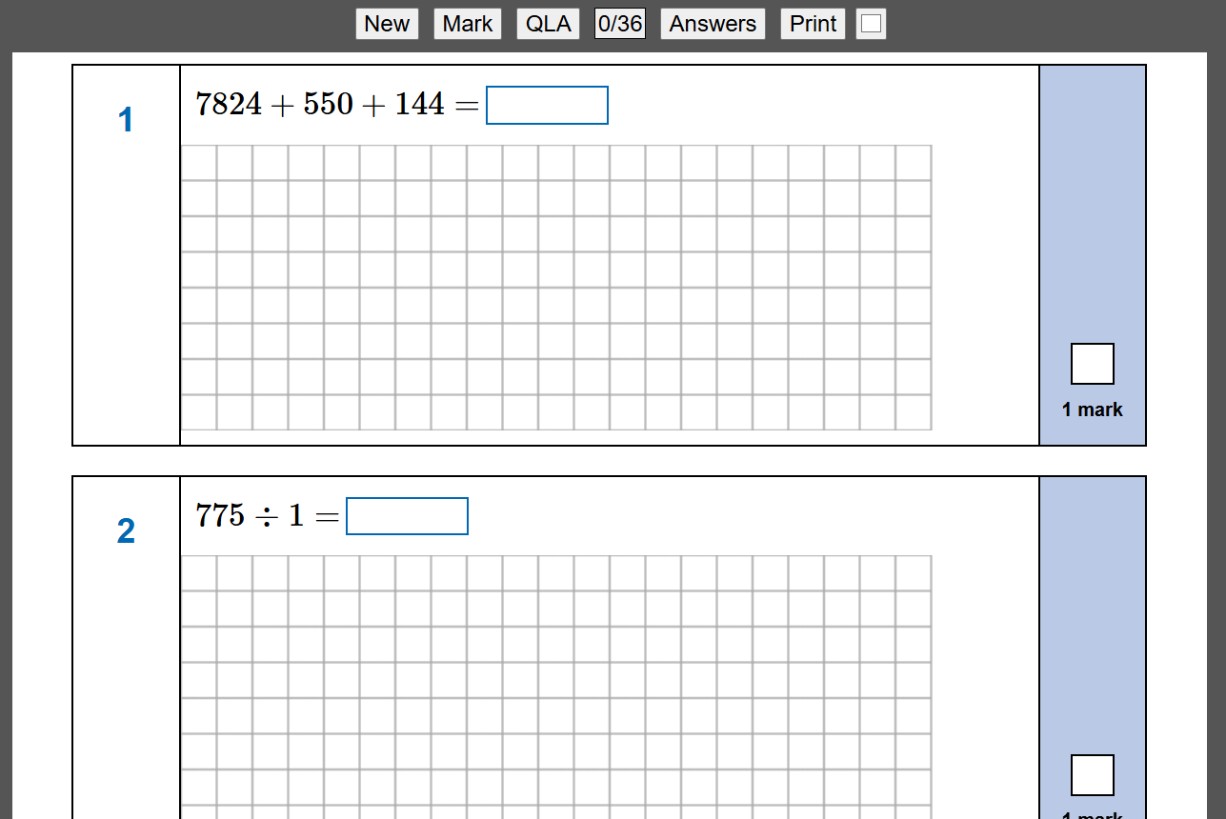
Useful resources
CGP practice books
https://mathsbot.com/primary/ks2

Slide 14
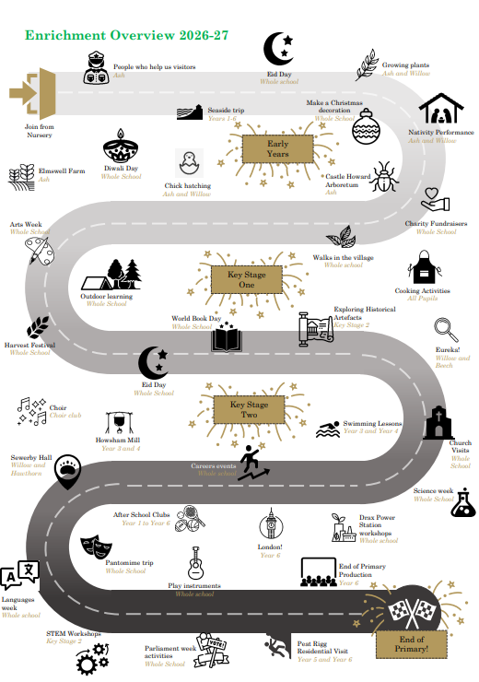
Enrichment

Slide 15
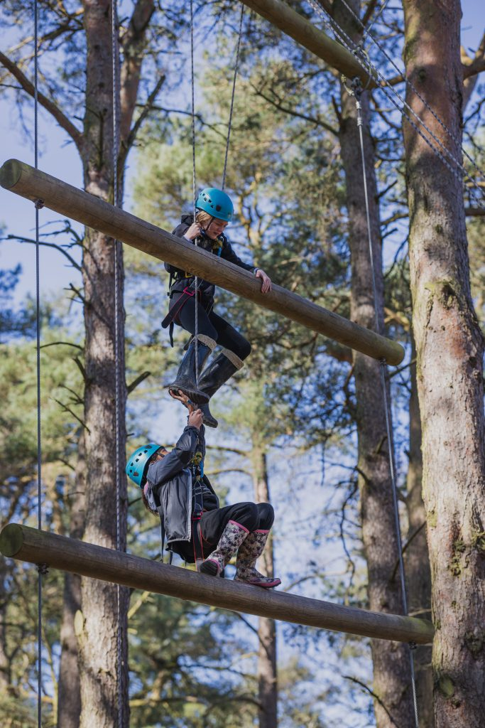
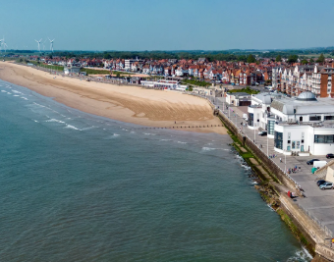

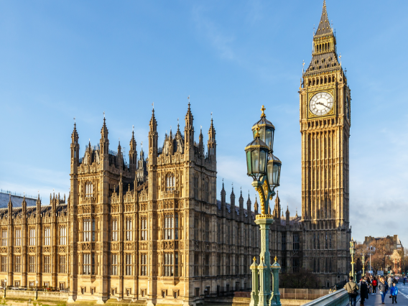
Trips this year
Bridlington Seaside
30th September
Peat Rigg
4th-6th November
York Grand Opera Pantomime
17th December
London
tbc

Slide 16


