Slide 1

Meet the Teacher
Willow Class

Slide 2
Aims
Curriculum – what your child will learn this year
Assessment – how we will assess what they know and what we will do to support
Enrichment – the fun activities we have planned to enhance our curriculum offer
How you can help at home
Questions…

Slide 3
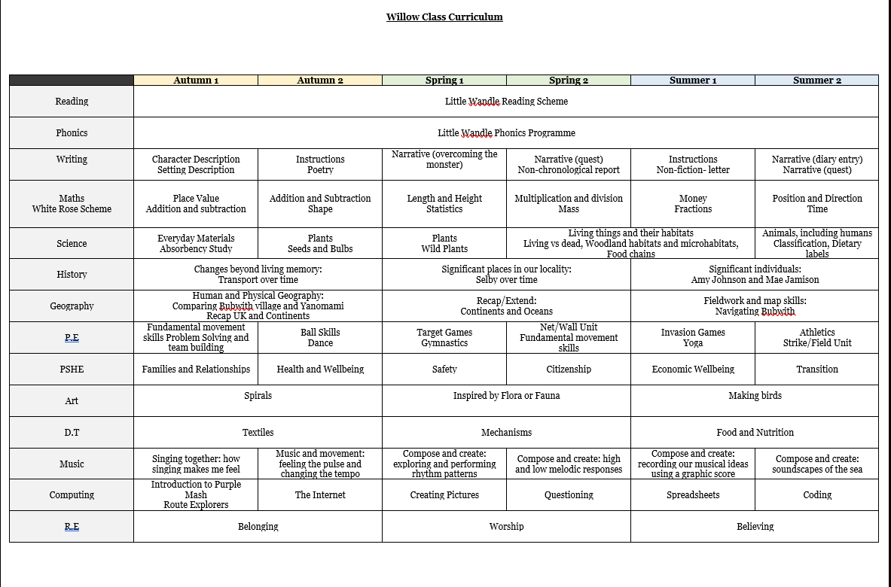
Curriculum overview

Slide 4
Curriculum Schemes of Learning
Maths- White Rose Scheme of Learning
Phonics and Reading- Little Wandle
P.E- Your P.E and Active-8 coaches to upskill staff
PSHE and RSE- Kapow
Computing- Purple Mash

Slide 5
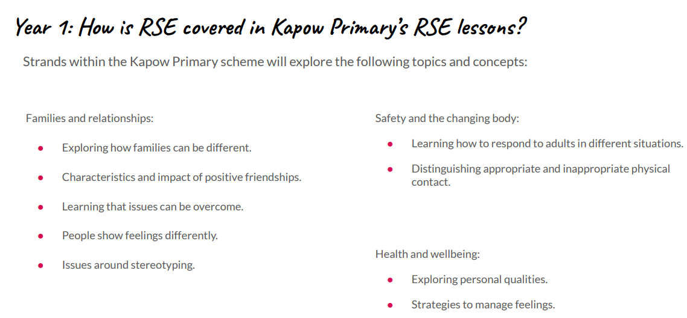
R.S.E in Year 1 and Year 2

Slide 6
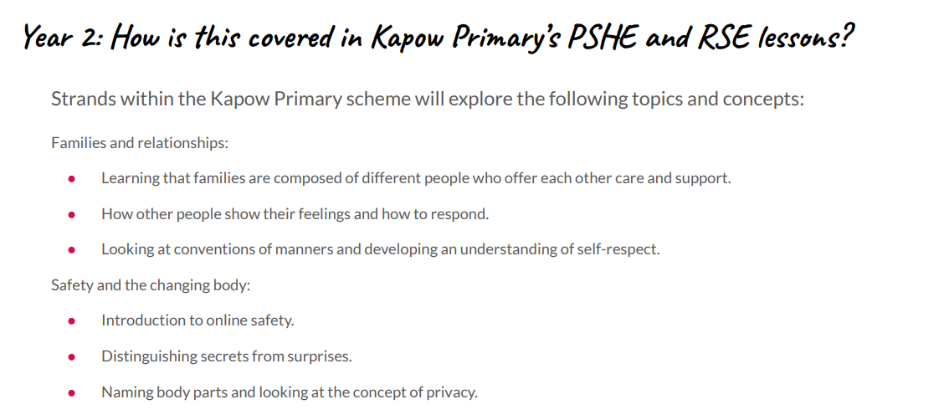
R.S.E in Year 1 and Year 2

Slide 7
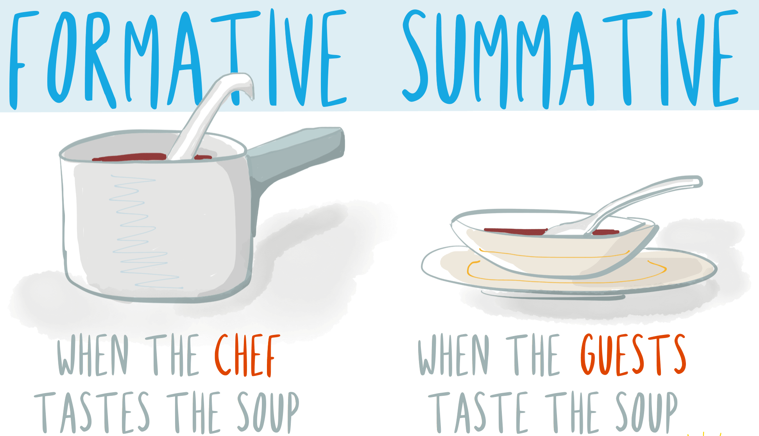
Assessment: internal
Daily:
Marking/Feedback
Asking questions
Interventions
Lesson quizzes
Termly:
Phonics assessment*
Reading assessment
Maths assessment
Writing teacher judgement
Progress updates are shared in parents’ evenings or on the door/over the phone.

Slide 8
Assessment
Reading and phonics- Half-termly Little Wandle assessments
Phonics Screening Check- Year 1 statutory assessment takes place in June
Mathematics- White Rose end of unit assessments and end of term assessments
General assessment- quizzes to identify understanding and address misconceptions

Slide 9
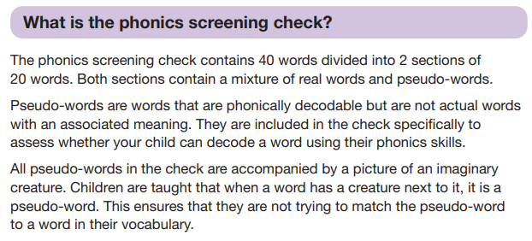
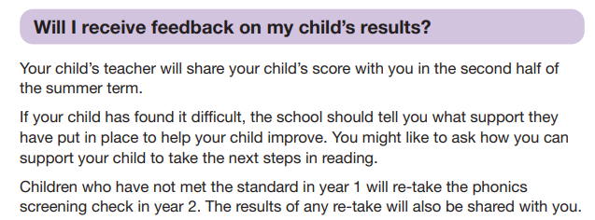
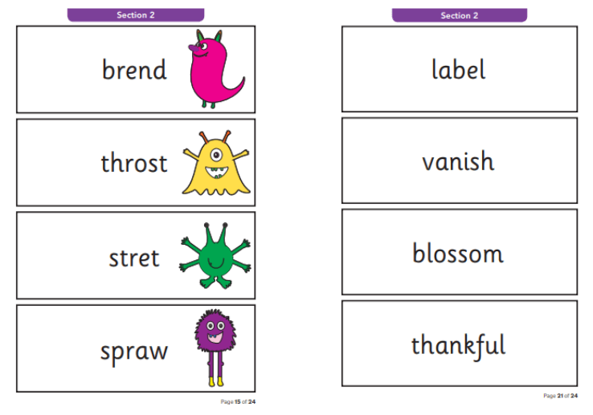
Statutory Assessments: Phonics Screening Check

Slide 10
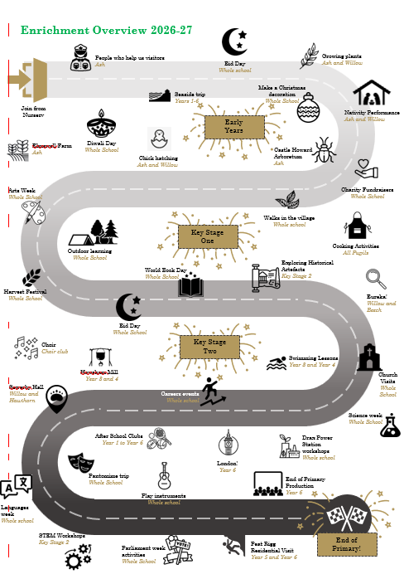
Enrichment

Slide 11
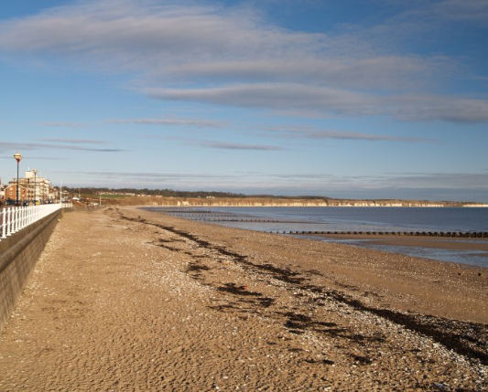
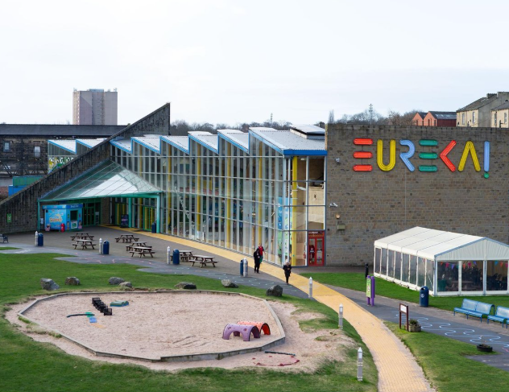
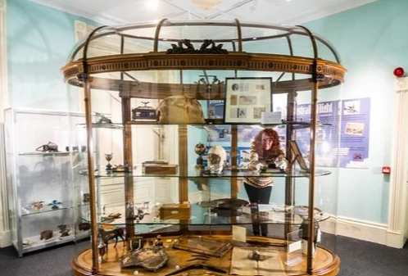
Enrichment- Willow Class
Autumn Term | Spring Term | Summer Term
Seaside trip Pantomime | Eureka Science Museum | Sewerby Hall

Slide 12

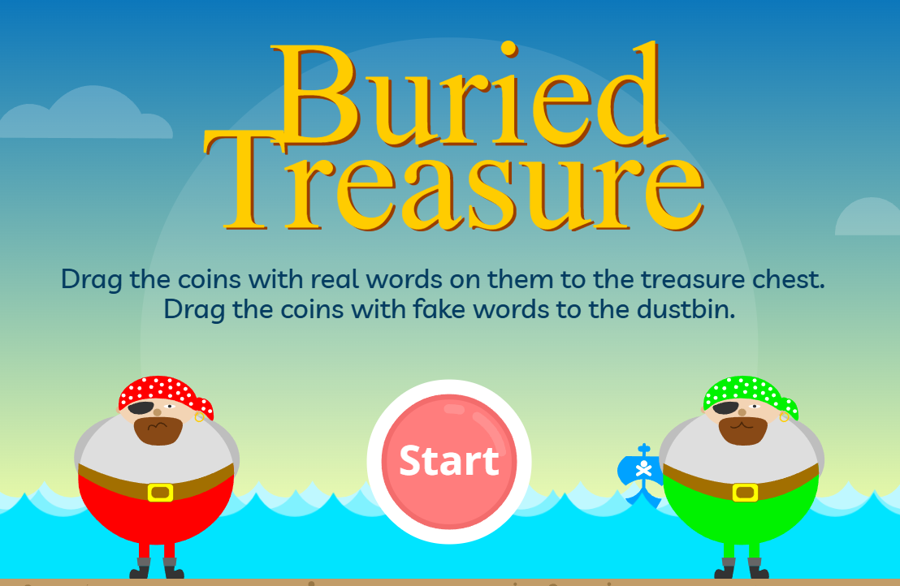

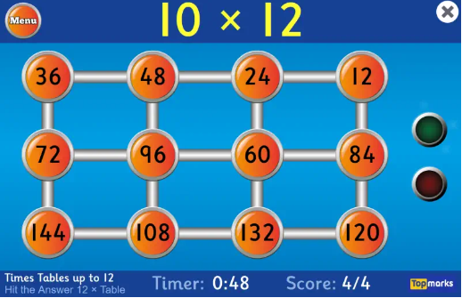
How you can help at home
Reading- regular reading makes a positive difference to a child’s academic outcomes!
Spelling practise each week
Maths- Regular practise of number bonds to 10 and 20 and times tables:
2, 3, 5 and 10-times tables
1-Minute Maths
Hit the Button - Quick fire maths practise for 6-11 year olds

Slide 13
Questions…

