Slide 1
Teach reading: change lives
Parent workshop: Phonics and early reading in Reception and Year 1, Phase 2 and Phase 5
(Autumn 1)
Notes:
For this presentation, you will need to download and print out the following resources and information for parents:
Phase 2 grapheme information sheet – Autumn 1
the parent handout ‘Your child’s reading journey – Reception Autumn term’
the Phase 2 and 3 grapheme mat
the Little Wandle Progression overview
‘Phase 2 tricky words: Reception Autumn term – Information for parents and carers’ – or parents can access this in the ‘For parents’ area of the Little Wandle website.
You will need a flipchart and access to the Little Wandle and Collins websites.
You may also wish to have a copy of the Little Wandle Glossary to hand (in Getting started/Teaching).

Slide 2
A love of reading is the biggest indicator of future academic success.
OECD (The Organisation for Economic Co-operation and Development)
Notes:
Suggested script:
Let's start our session with a quote from the Organisation for Economic Co-operation and Development ...
Read the quote.
This quote reminds us of the importance not just of teaching children to read, but also of teaching them to love reading.
Today, we're going to talk about phonics, but we always see phonics as the route into reading and a love of reading as our ultimate goal of phonics teaching.

Slide 3


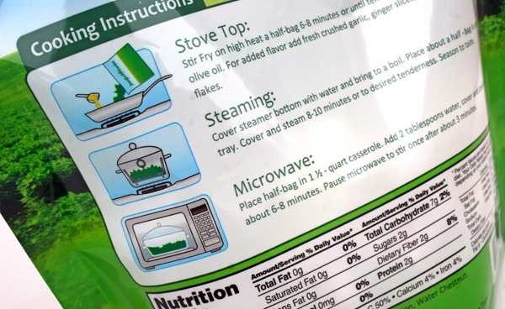
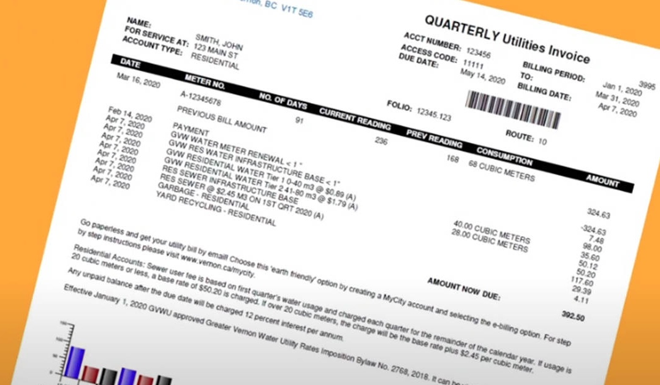
How many times have you already read today?
Notes:
Suggested script:
Just think about how many times you have already read things today. More than ever, we are surrounded by text and reading is a vital skill.
We want all of our children to become confident readers who can navigate the world of reading around them.

Slide 4

Phonics

Slide 5
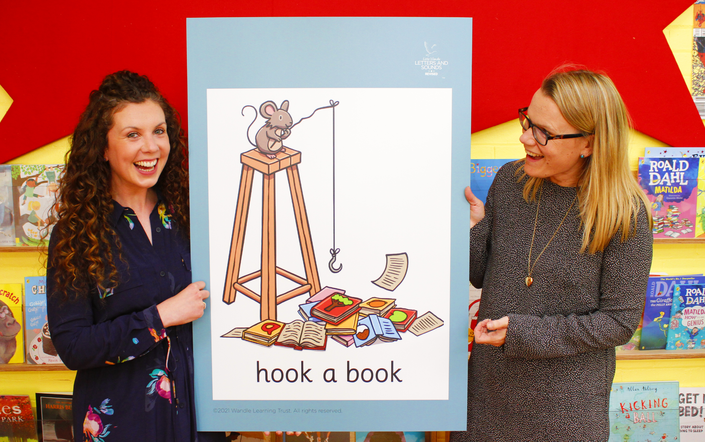
Little Wandle Letters and Sounds Revised
Our school has chosen
Little Wandle Letters and Sounds Revised as our Systematic Synthetic Phonics (SSP) programme to teach early reading and spelling.
Notes:
Suggested script:
The National Curriculum specifies that all schools must teach children to read using phonics in Reception.
Read the slide.

Slide 6
Phonics is:
making connections between the sounds of our spoken words and the letters that are used to write them down.
Notes:
Slide purpose:
To provide a simple definition of phonics
Suggested script:
So what is phonics? Thos of you who are parents of children in Year 1 or who have older children will have an idea.
Read the slide.
It sounds complicated but it really isn’t!
Let's learn some important words that will help you understand phonics ...

Slide 7
Terminology
Phoneme
Blend
Grapheme
Segment
Digraph
Trigraph
Notes:
Notes:
This is some of the terminology that we use when teaching phonics and the children will get used to using this too – we have some children in reception that are already using the word diagraph.
Phoneme – the smallest unit of sound that can be identified in words.
Grapheme – A letter or group of letters used to represent a particular phoneme when writing – example on board
Diagraph – a grapheme that uses 2 letters that make 1 sound e.g ai makes ai like rain. The children will get used to the mantra 2 letters 1 sound
Trigraph – a grapheme that uses 3 letters that make 1 sound e.g. igh make igh like night. The children will get used to the mantra 3 letters 1 sound.
Blend – To combine individual phonemes into a whole word. E.g. c a t blends to cat
Segment - To identify each of the individual phonemes in a word.

Slide 8
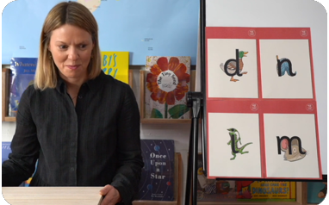
This term we are teaching Phase 2 in Reception
These are the first group of letters and sounds your child will learn.
We start teaching from week 2 of Reception.
The lessons are fun, interactive, engaging and have been designed to gradually build over time.
Notes:
Notes
Read the slide.
We usually teach four new sounds a week and have a review lesson on a Friday.
I have printed off a list of all the sounds we are learning during this phase for Reception parents to take home. This will help you with letter formation (handwriting) and pronunciation

Slide 9
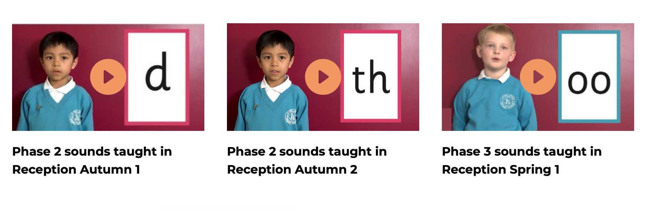
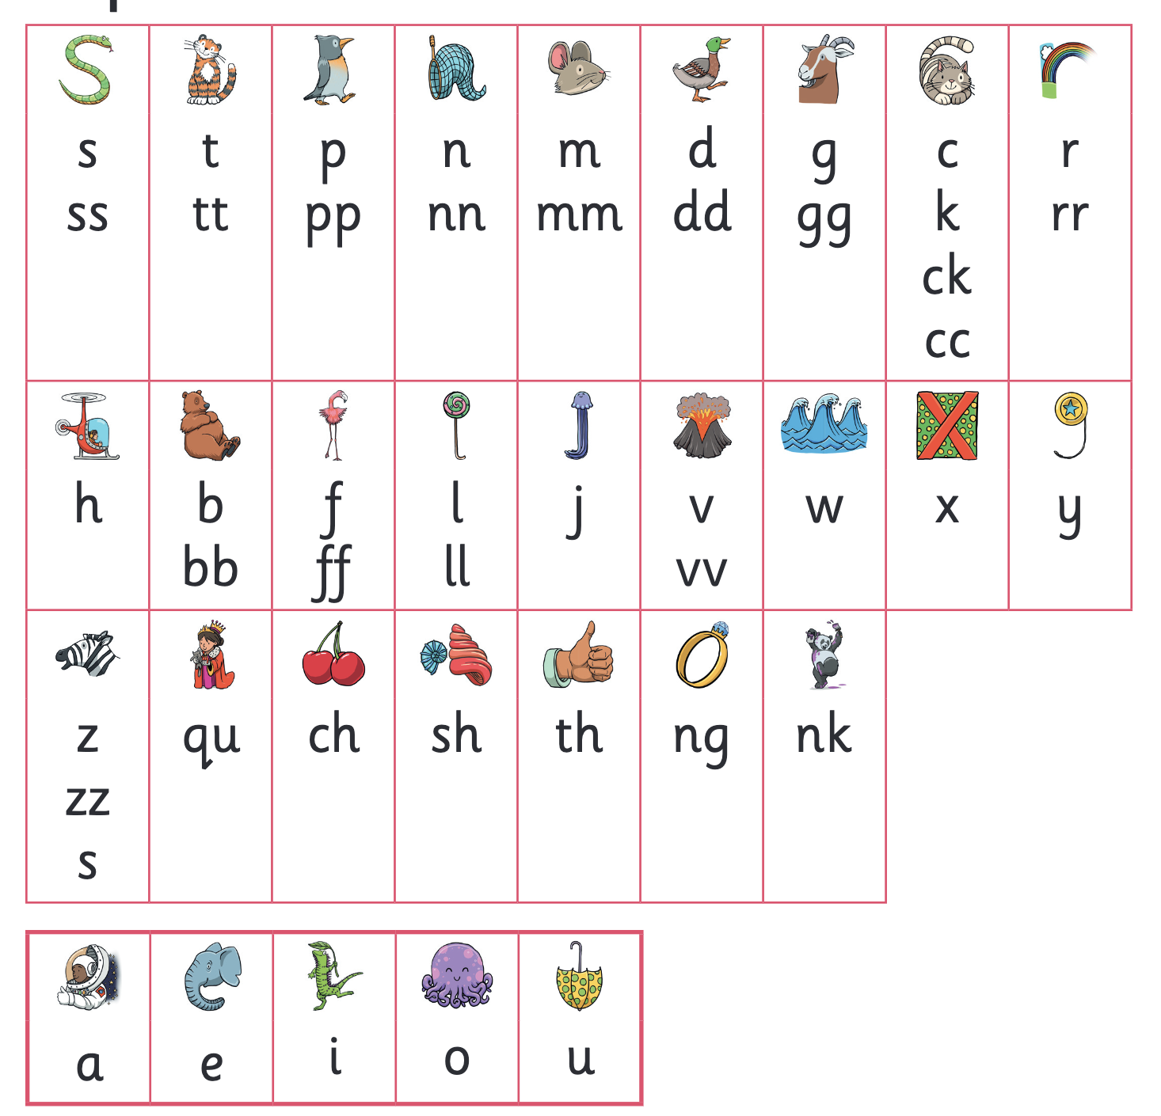
Phase 2 sounds
Notes:
Notes
When we say the sounds we use pure sounds which means we don’t say the uh at the end so instead of saying things nuh we say nnn.
Lets have a look at how to say the different sounds the children will learning during their time in reception.
Play the videos/teach the parents to say the Phase 2 sounds: https://www.littlewandlelettersandsounds.org.uk/resources/for-parents/
These videos are saved in the parents part of the Little Wandle website so if you are unsure you can have another look.

Slide 10
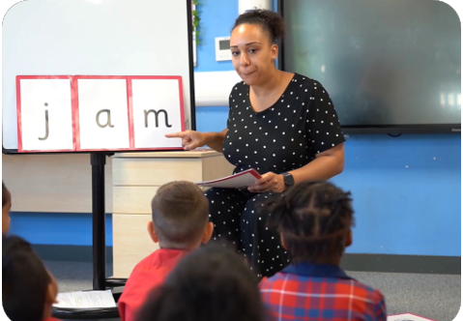
We teach blending so your child learns to read
Teacher-led blending is taught throughout Phase 2.
Our aim to is to teach every child to blend by Christmas.
We will inform you if your child needs additional practice.
Notes:
Suggested script:
Teacher-led blending is teaching children how to blend, directed and demonstrated by the teacher.
It is something we do in every phonics session as well as throughout the day when we have a spare few minutes e.g. when the children are lining up for lunch on getting ready for home. It is repeated daily in the Autumn term.

Slide 11
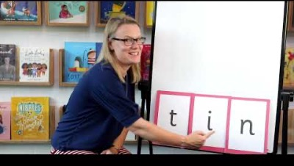
Blending to read words
Notes:
Suggested script:
Some children learn to blend really quickly, and others take a little longer but once it clicks that’s it they are away with it.
If your child is finding it difficult, ask your child’s teacher for ways to help at home – playing blending games at home is so helpful! Things like bingo/using magnetic letters can help.
I am just going to share with you a video on how we teach the children to blend in school.
Show parents the ‘How we teach blending’ video from ‘For parents’ area of the website: https://www.littlewandlelettersandsounds.org.uk/resources/for-parents/

Slide 12
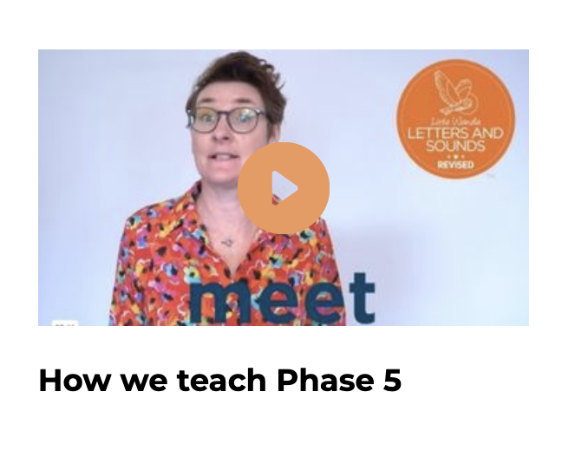
In Year 1 this term we are teaching Phase 5
In Phase 5 children learn:
new graphemes for the sounds they already know
that the same grapheme can have alternative pronunciations.
The ‘Grow the code’ lessons support children with reading and spelling these alternative spellings.
Notes:
Suggested script:
The children learn the last set of graphemes, including ones with alternative pronunciations.
They will also learn to ‘Grow the code’ where children will explore different ways of spelling the same phoneme and reading the same grapheme. This means that they are able to read increasingly challenging words and books.
‘Growing the code’ will support children as they get older with accurate spelling.
Play the video which explains how we teach Phase 5.

Slide 13
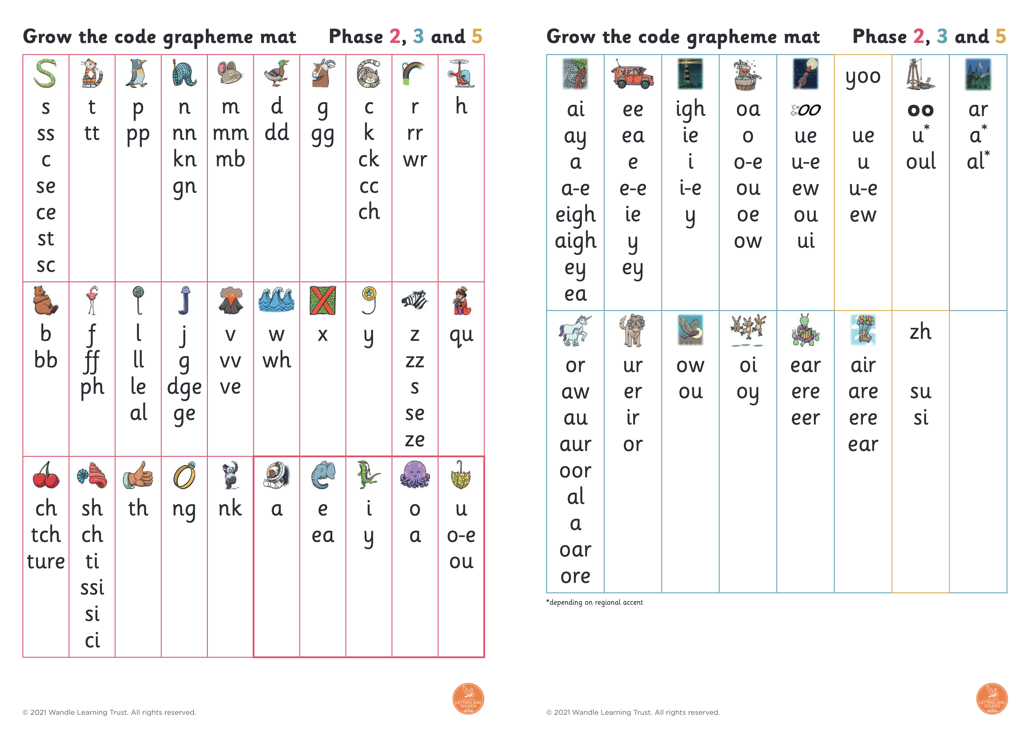
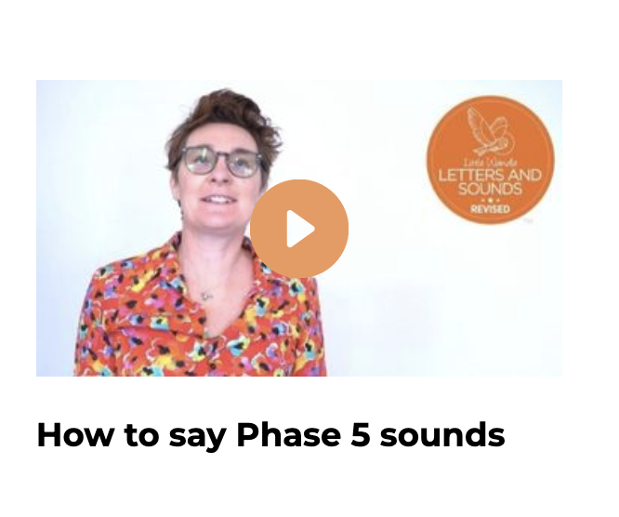
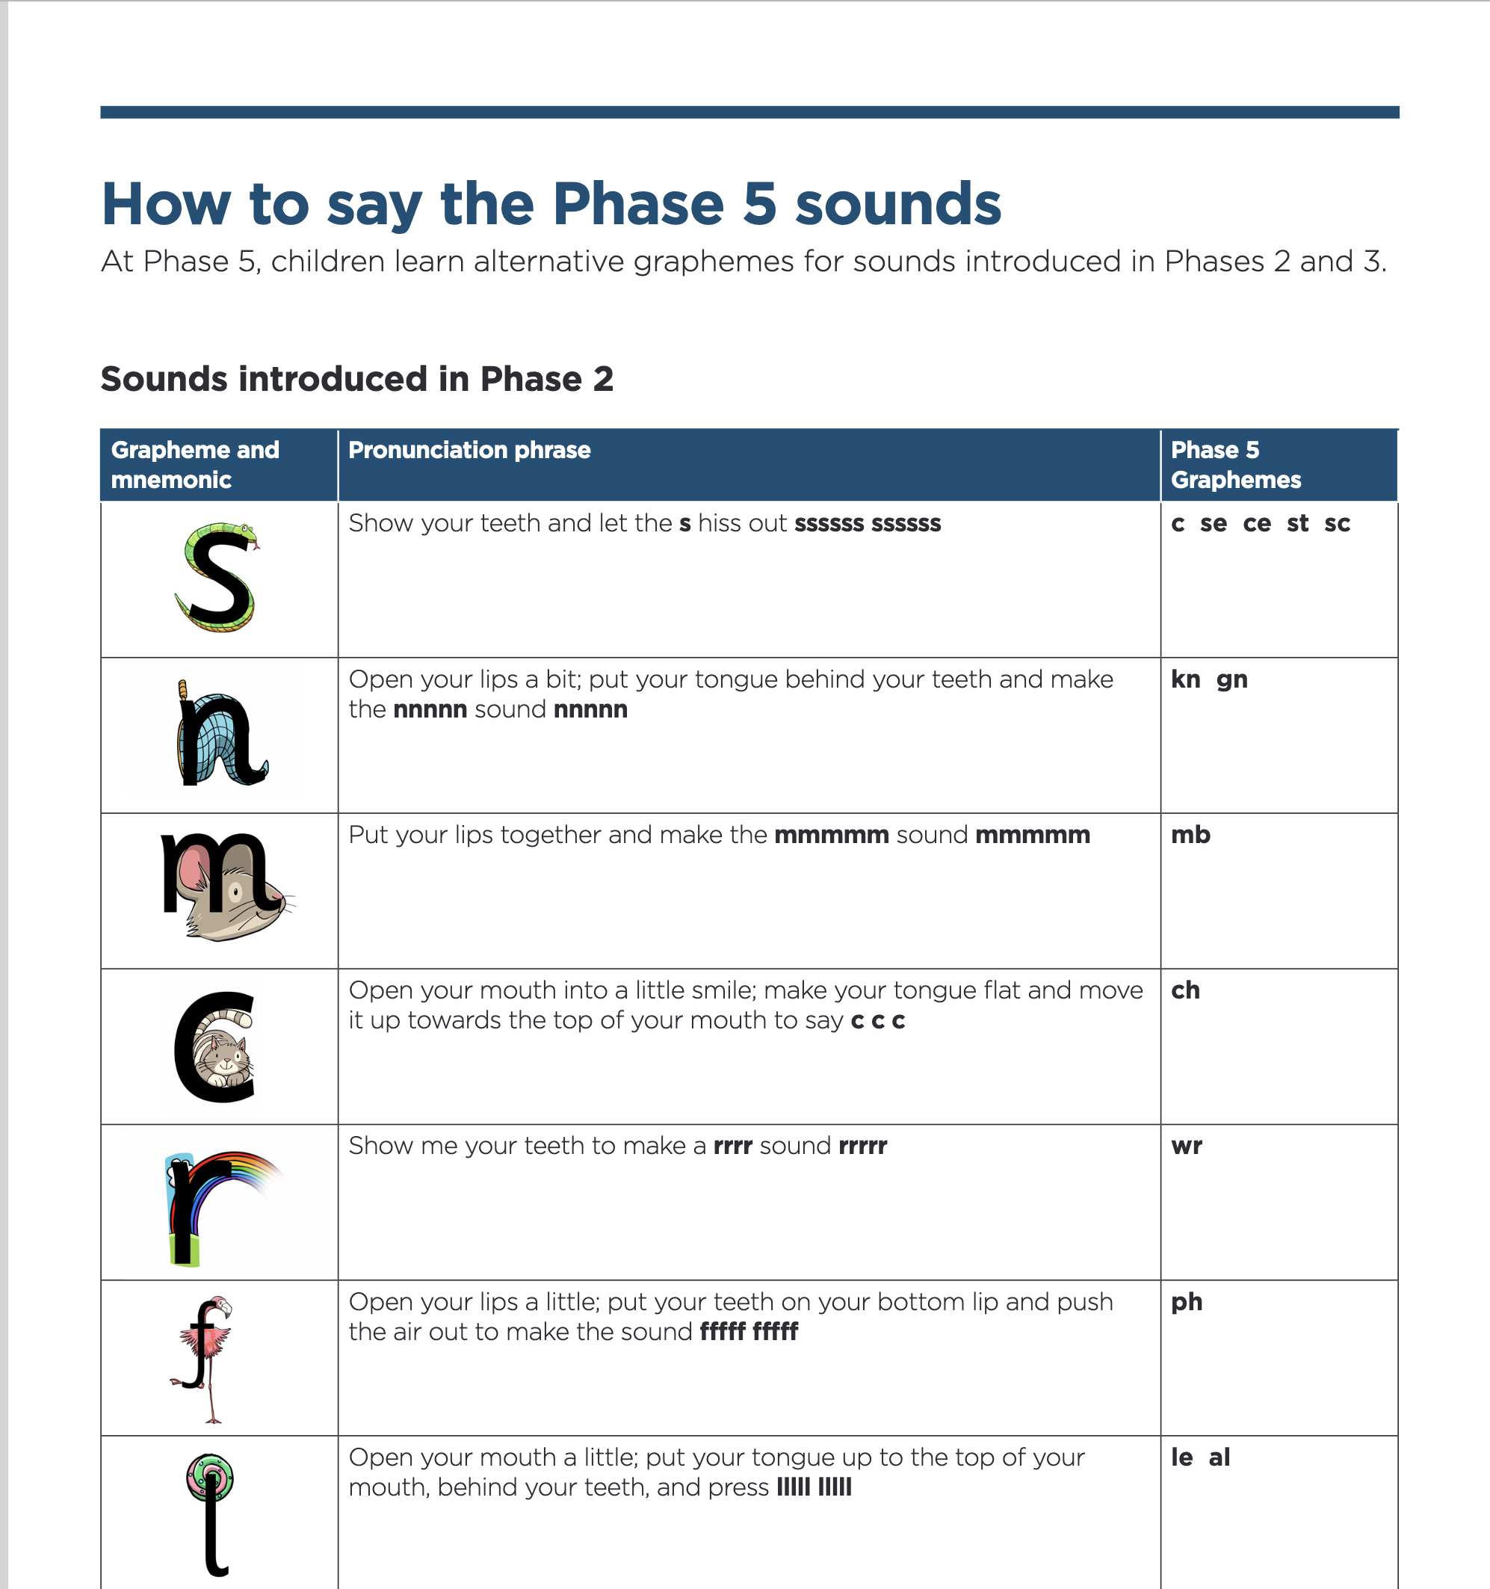
Phase 5 sounds
Notes:
Suggested script:
Let's have a look at the Phase 5 sounds.
Play the video.
I have put the grow the code chart on the screen – lets have a little practice. – point to sounds for parents to have a go at.
Again as with the Phase 2 video this one is also in the parents section on the little wandle website so if you are not sure of a sound you can have a look.

Slide 14
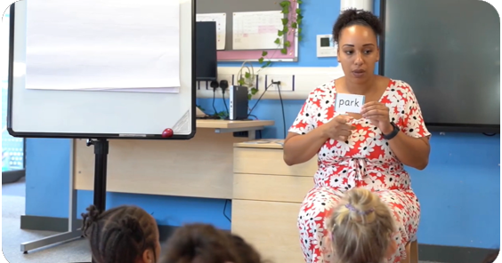
Reading words in Year 1
Children will be able to:
blend independently
blend in their heads with increasing fluency and confidence.
They will also begin to distinguish between different phonemes/graphemes.
Notes:
Suggested script:
Read page
In Year 1 most children will now be confident using the strategy ‘blend in your head’ to build their fluency.
Blending in your head means children say the sounds quietly in their heads and then read the whole word out loud.
If your child is struggling with a word, encourage them to blend in their head.
Children are also taught to spot digraphs in words before reading the word as a whole. This also helps their developing fluency.
Eventually, reading becomes automatic and children will be able to read words that they know fluently.
Fluency is the ultimate goal of phonics teaching

Slide 15
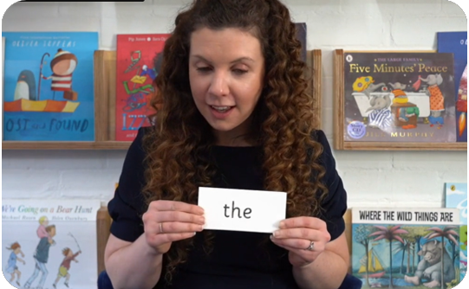
Tricky words
These words have unusual spellings e.g. he, the, was.
They are taught in a systematic way.
Children in Reception are now learning to read the Phase 2 tricky words and children in Year 1 are learning to read Phase 5 tricky words.
Notes:
Notes:
Tricky words have unusual spellings. For example ‘all' is tricky to children in Reception because the letter ‘a’ says /or/ in this word.
Tricky words are taught in a systematic way, following the clearly defined Little Wandle sequence of learning. We teach them because they are common words that children need to know.

Slide 16
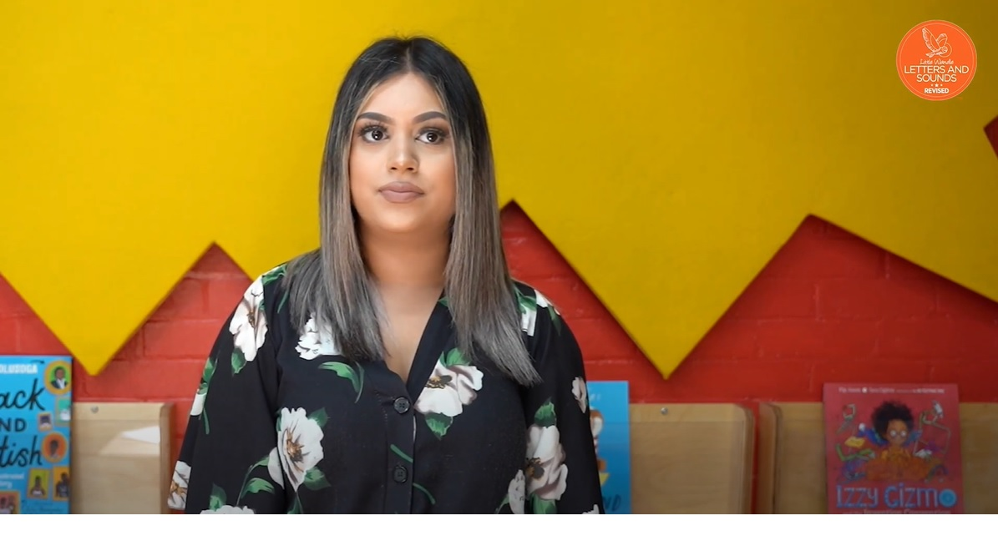
Reading tricky words
Notes:
Notes
It is important children practise tricky words frequently to ensure that they can read them automatically to help them build up their fluency.
I am just going to show how we teach reading tricky words.
Watch the ‘How we teach tricky words’ video on the website: https://www.littlewandlelettersandsounds.org.uk/resources/for-parents/

Slide 17
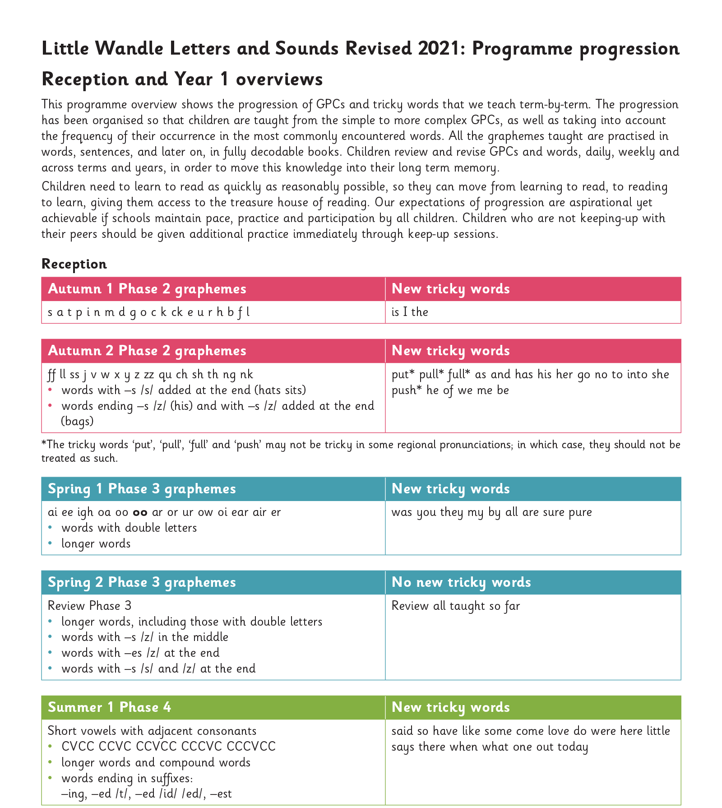
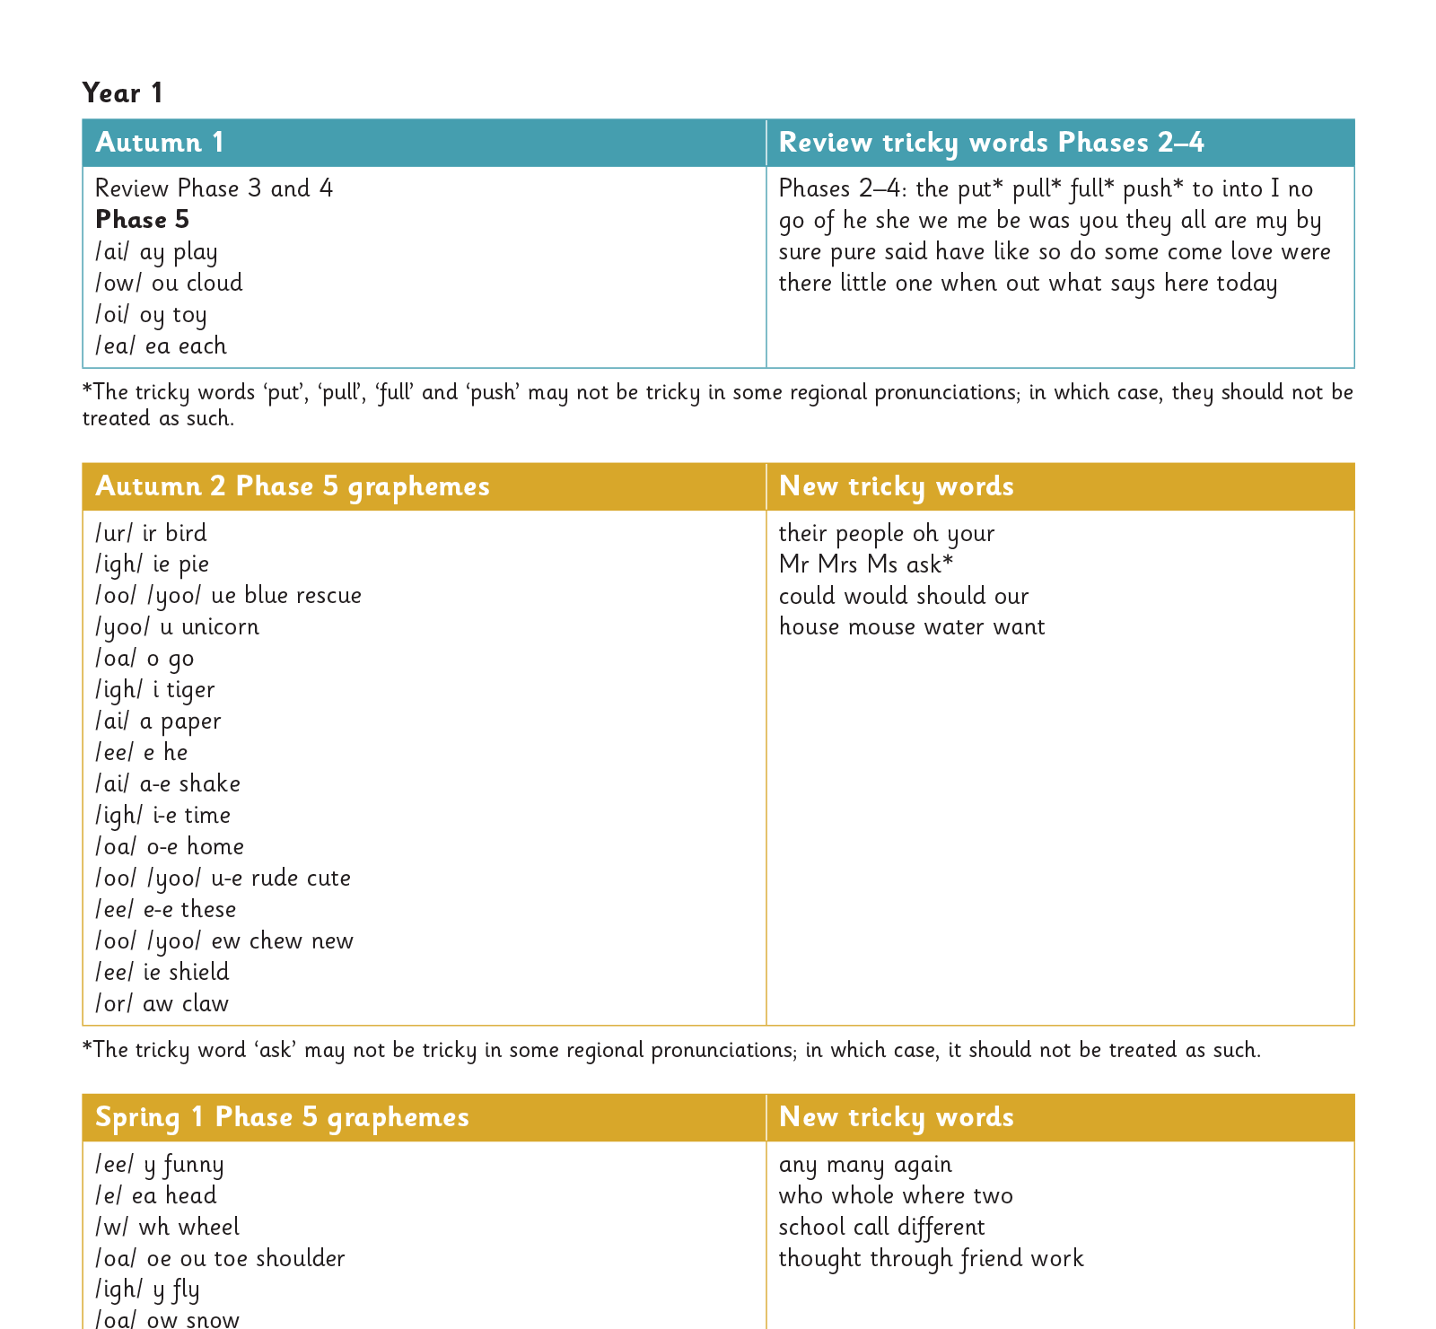
Progression from Reception to Year 1
Notes:
Suggested script:
The children in reception will work their way through phases 2,3 and 4.
The children in Year 1 have just had a brief review of Phases 3 and 4 and all of the Reception tricky words.
They have now begun phase 5.
Phase 5 covers the last remaining graphemes of the Little Wandle progression and alternative pronunciations and spellings of graphemes learned.

Slide 18
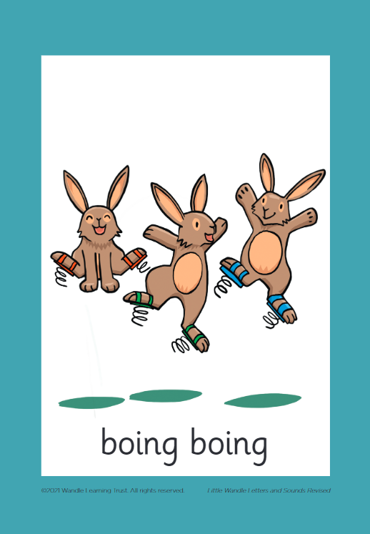



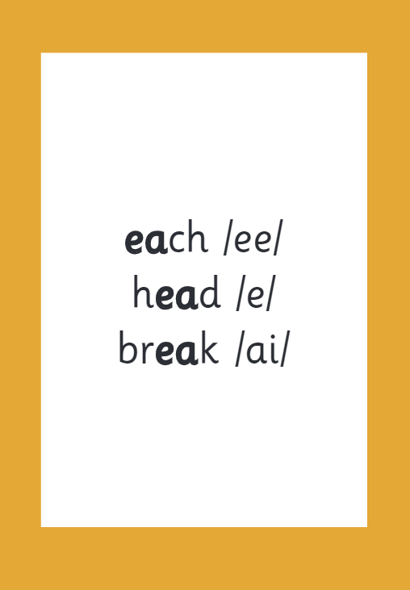

How we make learning stick
Notes:
Suggested script:
There are specific resources for the Little Wandle Programme which the children will be very familiar with.
Each sound that we teach to begin with has either a mnemonic (like the astronaut that you can see here) or a phrase like boing-boing for ‘oi’. This helps the children recognise and remember the graphemes.
Every time we teach a new sound, we also read words during the phonics lesson that contain that new sound so that the children practise what they have learned.
We then go on to reading a sentence containing some of those words.
We have displays in the classroom and on the tables to support the children throughout the day.

Slide 19
Reading and spelling

Slide 20
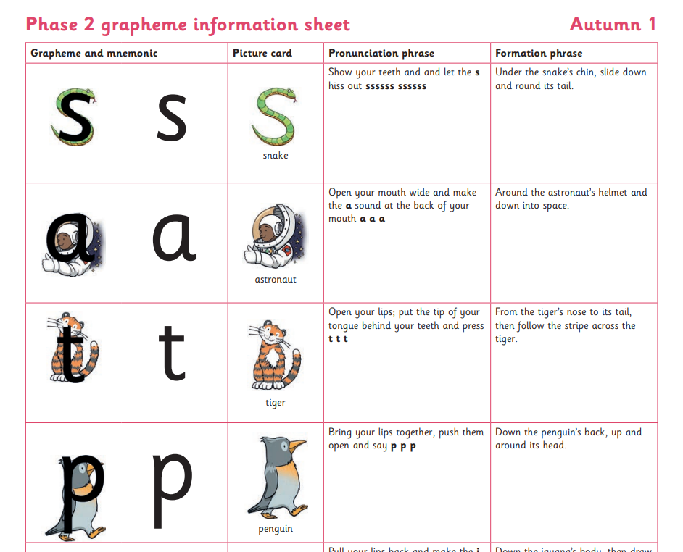

Spelling in Reception
Your child will be taught how to spell simple words, using the graphemes they have been taught.
They will practise the correct formation of letters. They will also have handwriting lessons.
Notes:
Notes:
Read the slide.
Hand out the Phase 2 grapheme information sheet for Autumn 1, which includes the formation phrases.

Slide 21
Spelling in Year 1
This term, your child will be taught how to spell words every day using the graphemes they have been taught so far.
They will practise writing a dictated sentence.
Handwriting is referred to but is taught at other times of the day.
Notes:
Suggested script:
In Year 1, there are increasingly challenging words to spell, e.g. longer words and plurals. This all matches the Little Wandle sequence of learning.
The children will also practise writing a dictated sentence on a Friday. Their teacher will say the sentence, show them how to write it and then ask the children to write it independently.
Handwriting phrases learned in Reception are referred to during the lesson, but the specific practice of handwriting is taught separately.

Slide 22

How do we teach spelling?
Say the word.
Segment the sounds.
Count the sounds.
Write them down.
Notes:
Notes:
Model the process above on a flipchart for the parents to see.
Show the process with a Phase 2 word, e.g. pin, dig, hug phase 5 word - play.

Slide 23
How do we practise reading in books?
Reading practice sessions are:
timetabled three times a week
taught by a trained teacher/teaching assistant
taught in small groups
Children will then bring these books home to share with you.
Notes:
Suggested script:
The children read the same book three times in a week with either a trained teacher or teaching assistant.
The first time we work on decoding (sounding out) the words, the second time we work on prosody which is reading with expression – making the book sound more interesting with our story-teller voice or our David Attenborough voice – and the third time we look at comprehension.
We read the books three times at school because we want to develop the fluency.
The more children see words, the more they begin to read them automatically without having to sound them out.
The children will then bring their books home to share with you.

Slide 24
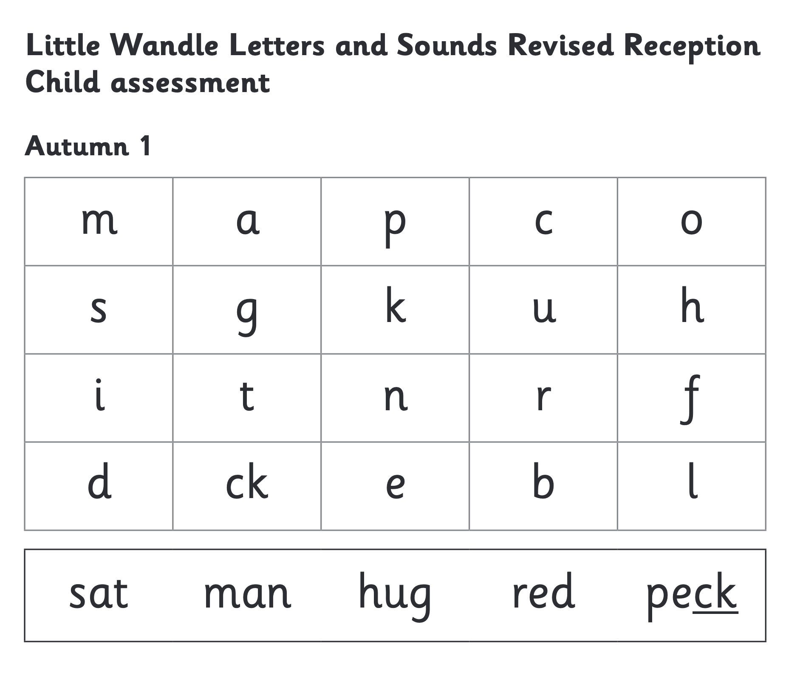
How do we find the right book for your child?
Notes:
Suggested script:
We assess your child every six weeks to check progress.
Any child who needs extra support has Daily Keep-up sessions planned for them.

Slide 25
Reading at home

Slide 26

Books going home
Notes:
Suggested script:
As well as the ‘learning to read’ book that your child will bring home they will also bring home a book for sharing with you.
This shared book is SO important. This is how we are going to give them the WILL to read.
Please read with your child as often as you can – at least once a day if possible.

Slide 27
Listening to your child read their phonics book
Your child should be able to read their book without your help.
They might sound out words and blend them before they read them fluently.
If they can’t read a word, encourage them to sound it out and blend it.
Talk about the book and celebrate their success.
Notes:
Notes
As already mentioned, your child will bring home their phonics book, matched to their reading ability, which they will have already read in school.
The purpose of this book is to practise their fluency.
Children shouldn’t find reading their phonics book hard! We want them to bring a book home that they can read mostly fluently. We have done the teaching of reading the book in school, we want them to show off their skills to you and celebrate their successes with you.
Should only need to stop and sound out about 5% of the words by the time they bring the book home
If your child is finding a word hard to read, encourage them to sound and blend.
Once your child is reading a Phase 3 book, we encourage them to ‘blend in their heads – (Blending in your head means children say the sounds quietly in their heads and then read the whole word out loud)
Please remember to write down in your childs reading record when you have listened to them read – you don’t always have to write a comment – just an initial in more than enough.

Slide 28
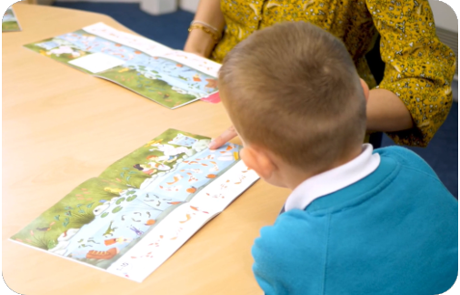
Reading a wordless books
Wordless books are invaluable as they teach reading behaviours and early reading skills to children who are not blending – yet!
Talk about the pictures.
Point to the images in the circles and find them on the page.
Encourage your child to make links from the book to their experiences.
Notes:
Notes:
Read the slide.

Slide 29

The sharing book
The shared book is for YOU to read:
Make the story sound as exciting as you can by changing your voice.
Talk with your child as much as you can:
  Introduce new and exciting language.
  Encourage your child to use new vocabulary.
  Make up sentences together.
  Find different words to use.
  Describe things you see.
Notes:
Notes:
Reading to your child daily can open a variety of doors to your child's education, imagination and well-being. The sharing book is a book for you to read and enjoy with your child.
Read the slide.
As a school, we also prioritise reading to the children daily to encourage the love of reading.

Slide 30
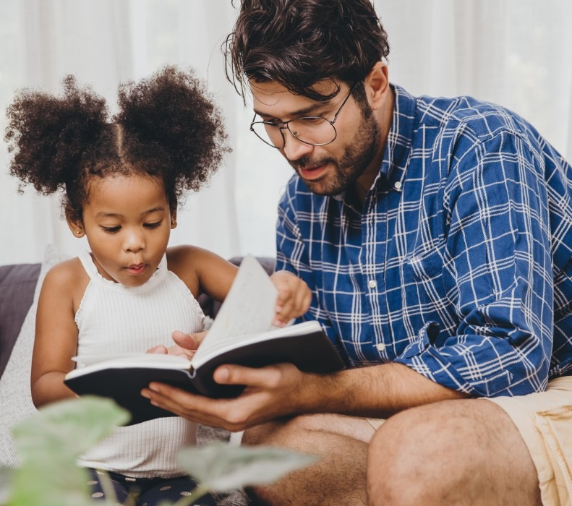
The most important thing you can do is read with your child
Reading a book and chatting had a positive impact a year later on children’s ability to…
understand words and sentences
use a wide range of vocabulary
develop listening comprehension skills.
The amount of books children were exposed to by age 6 was a positive predictor of their reading ability two years later.
Parental involvement in the development of children’s reading skills: A five-year longitudinal study (2002) Senechal, M. and Lefvre, J
Notes:
Suggested script:
Read slide.
The Everybody read! part of the Little Wandle website has lots of book recommendations. Anyone can access it and find lots of lovely book recommendations for their children.
Click on link to show Everybody read! section of website: https://www.littlewandlelettersandsounds.org.uk/resources/my-letters-and-sounds/everybody-read/
Celebrate your child’s success at school.
Make time for reading at home.

Slide 31
One of the greatest gifts adults can give is to read to children
Carl Sagan
Notes:
Notes:
I am just going to end with this quote.
Thank you so much for coming.
The sheets are on the tables for you to take away.
I know I have just bombarded you with lots of information but if anyone has any questions please ask myself or speak to your childs teacher.
Thank you.

