Slide 1
September Reading for Pleasure Competition

Slide 2
January
Reading for Pleasure Competition

Slide 3
Design a Book Cover.

Slide 4

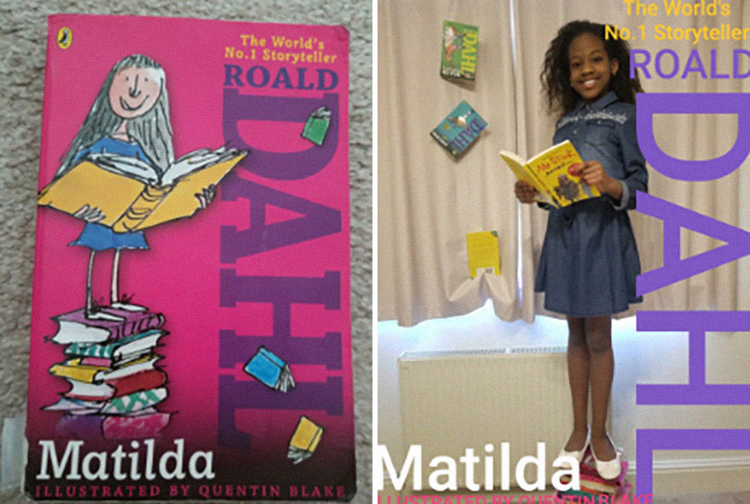


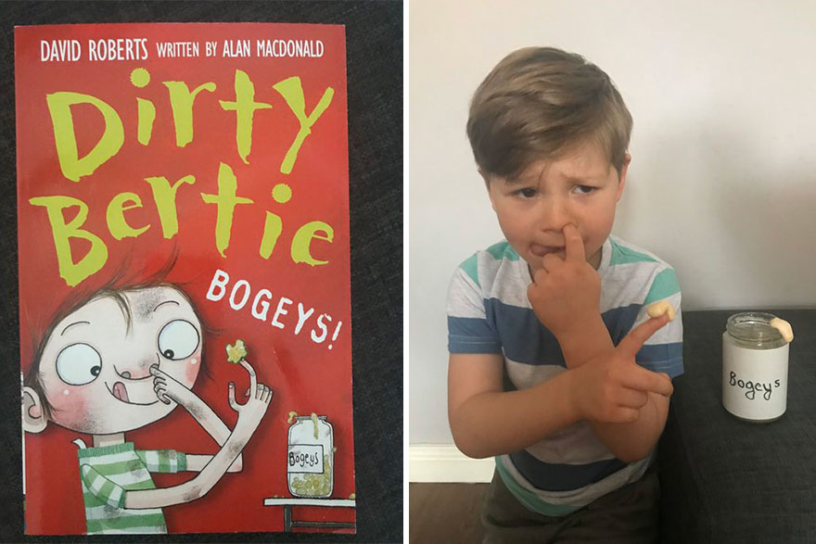

Slide 5
All entrants must be handed in to your class teacher with your name and class on the back.
Deadline = Wednesday 31st January.
Winners announced in that Friday’s celebration assembly

Slide 6
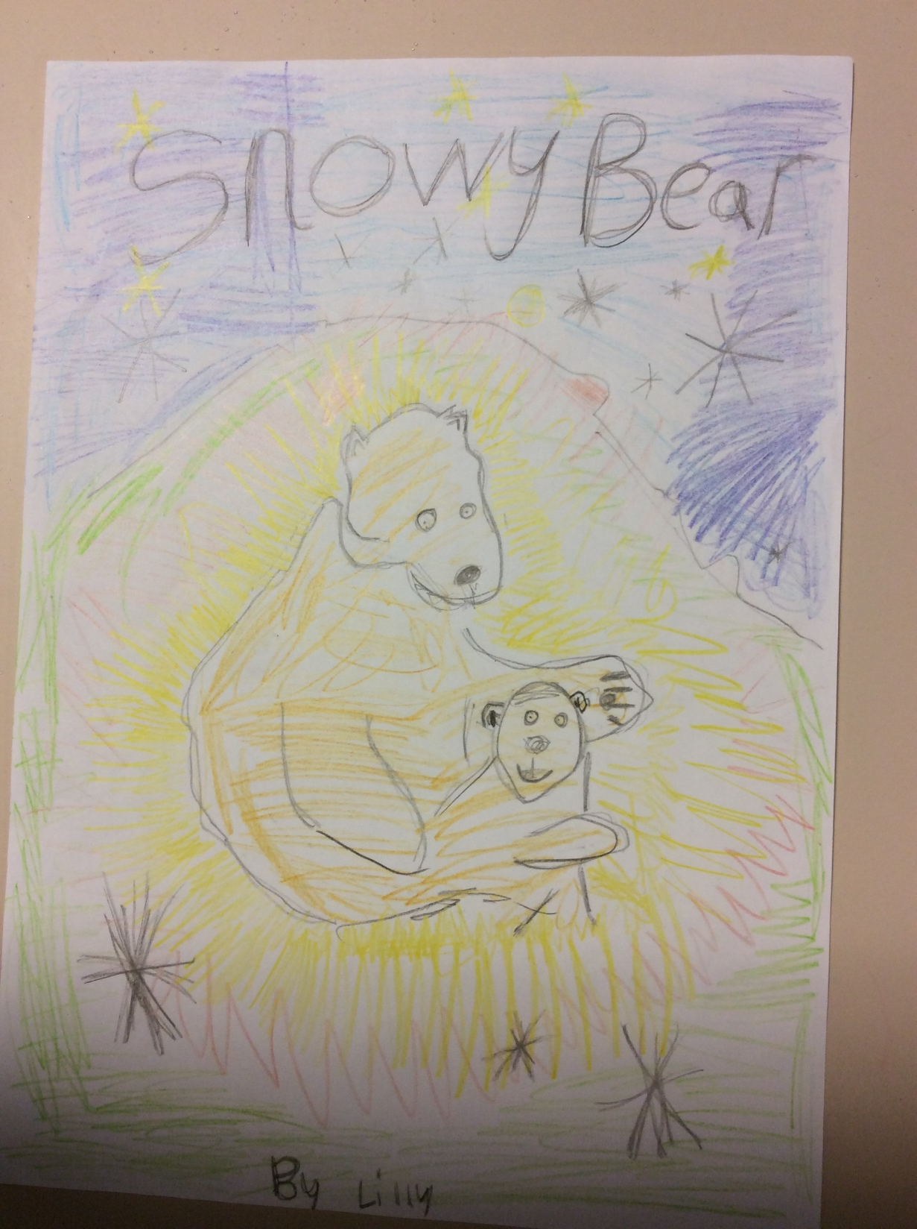
KS1 runner up
Lily Harrison, Ash Class

Slide 7
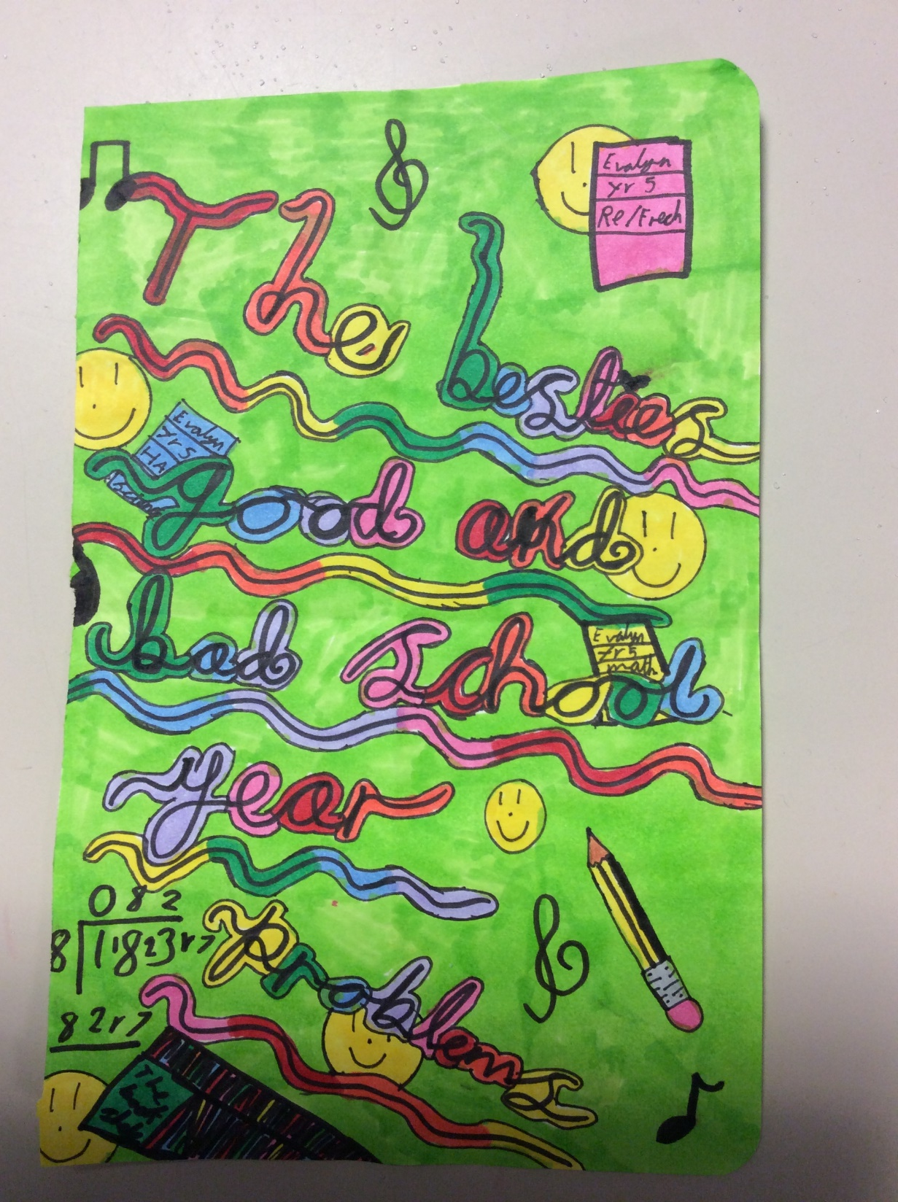
KS2 runner up
Evelyn Pilmoor, Hawthorn Class

Slide 8
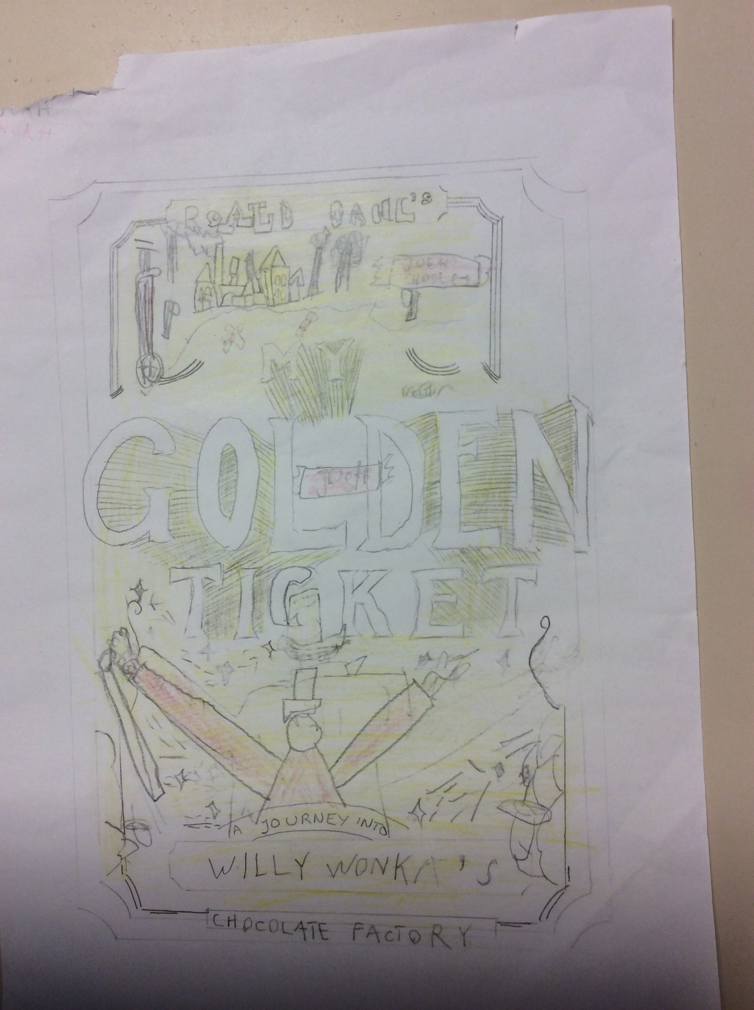
KS1 winner
Joshua Holmes, Ash Class

Slide 9
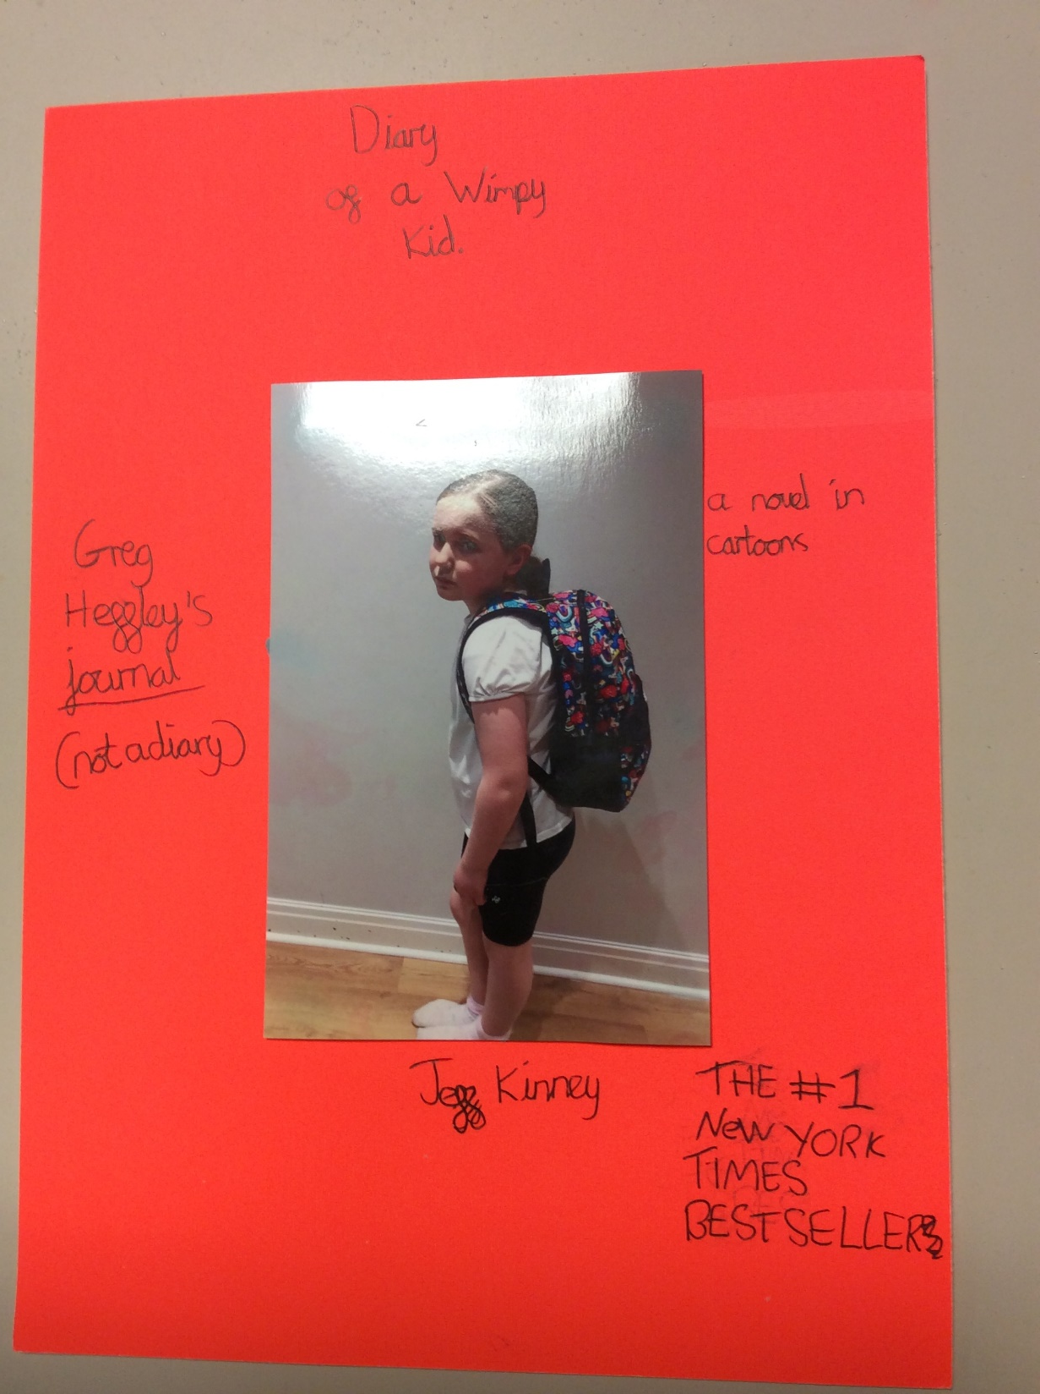
KS2 winner
Ruby Millet, Hawthorn Class

Slide 10
February
Reading for Pleasure Competition

Slide 11
Valentine’s Day Card

Slide 12




Slide 13
All entrants must be handed in to your class teacher with your name and class on the back.
Deadline = Thursday 29th February.
Winners announced in that Friday’s celebration assembly.

Slide 14
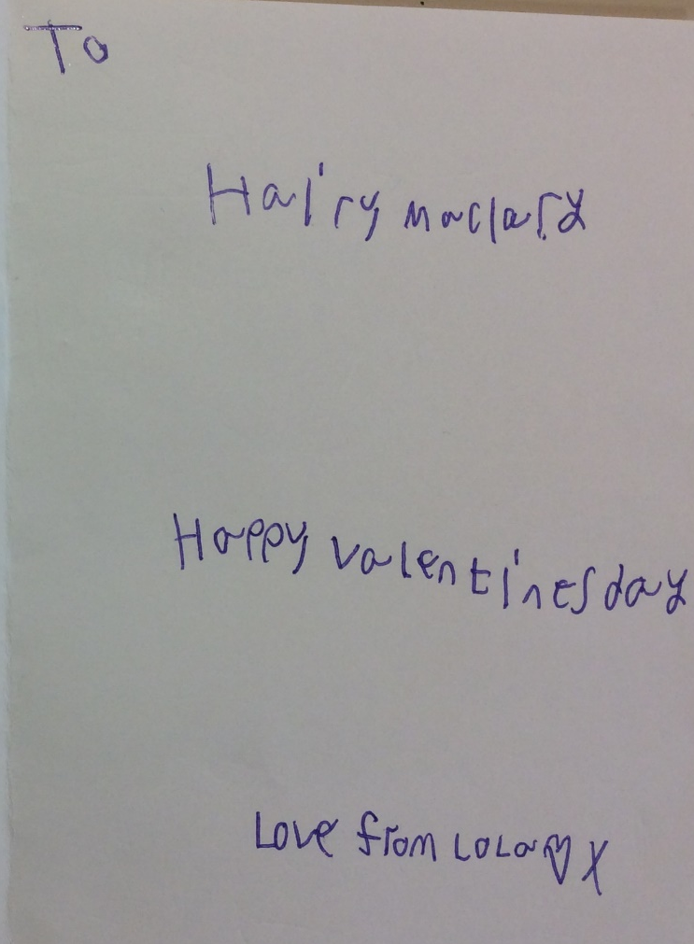
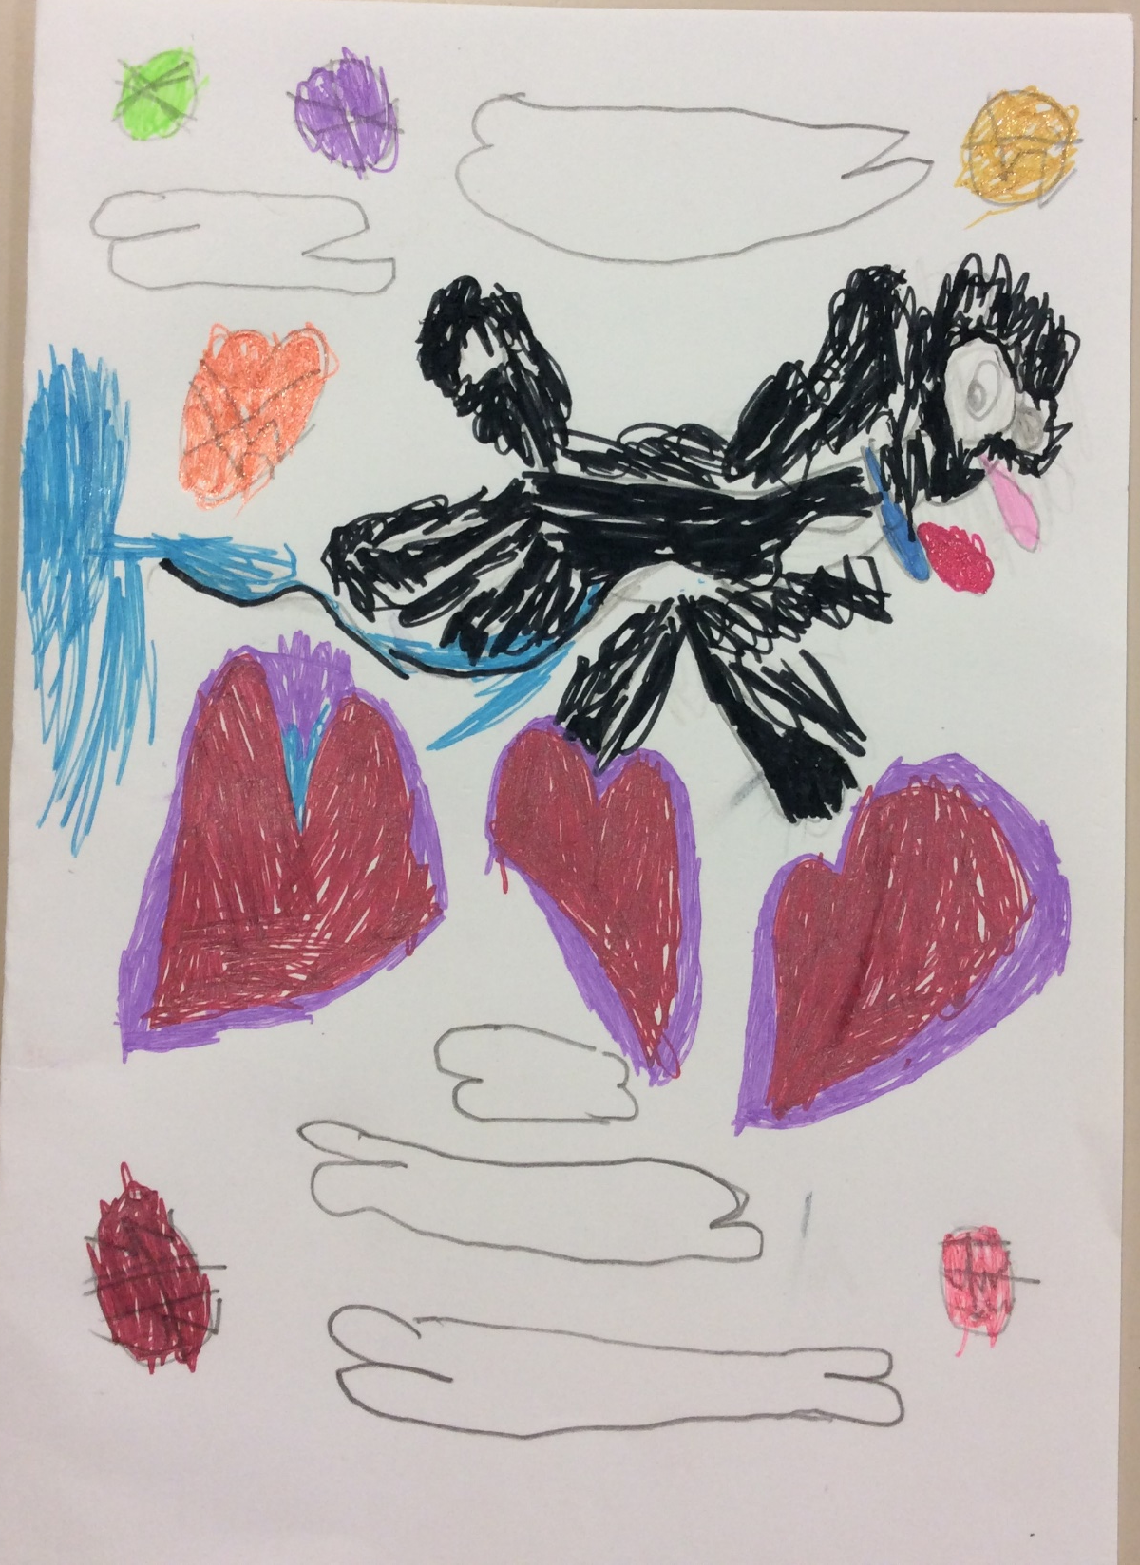
EYFS/KS1 runner up
Lola Hoole, Willow Class

Slide 15
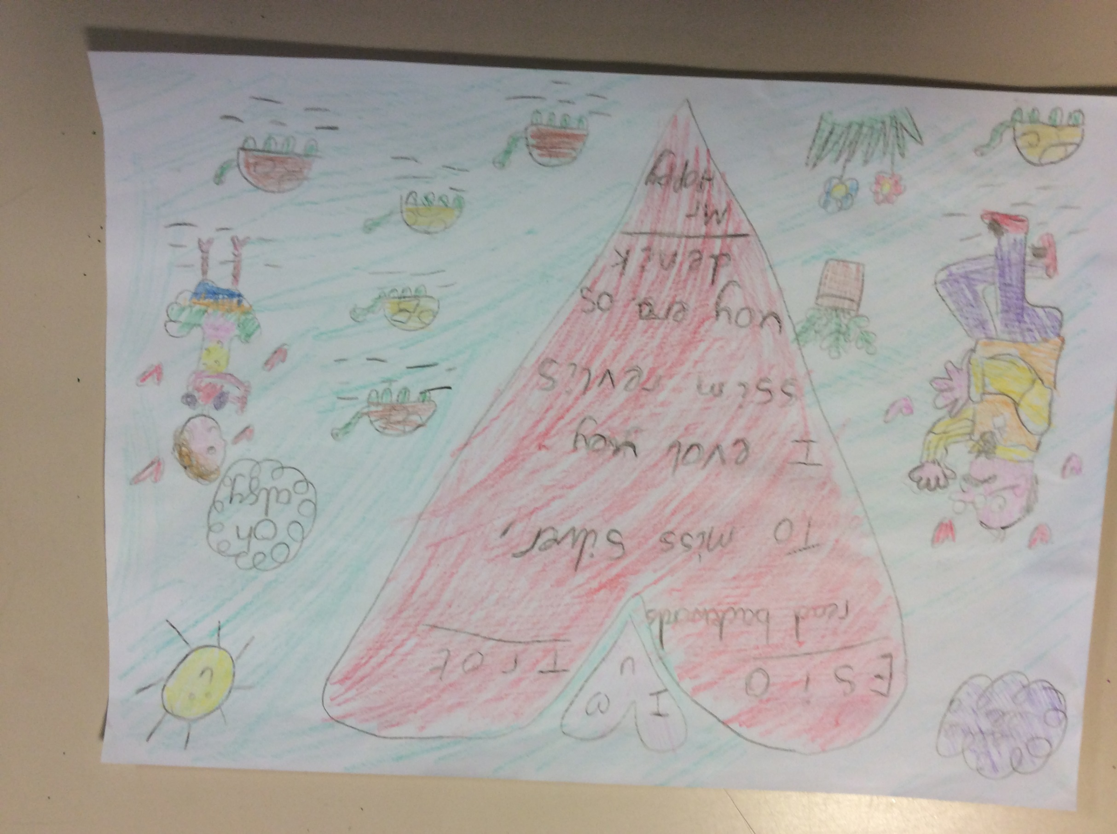
KS2 runner up
Eliza Clarke, Beech Class

Slide 16
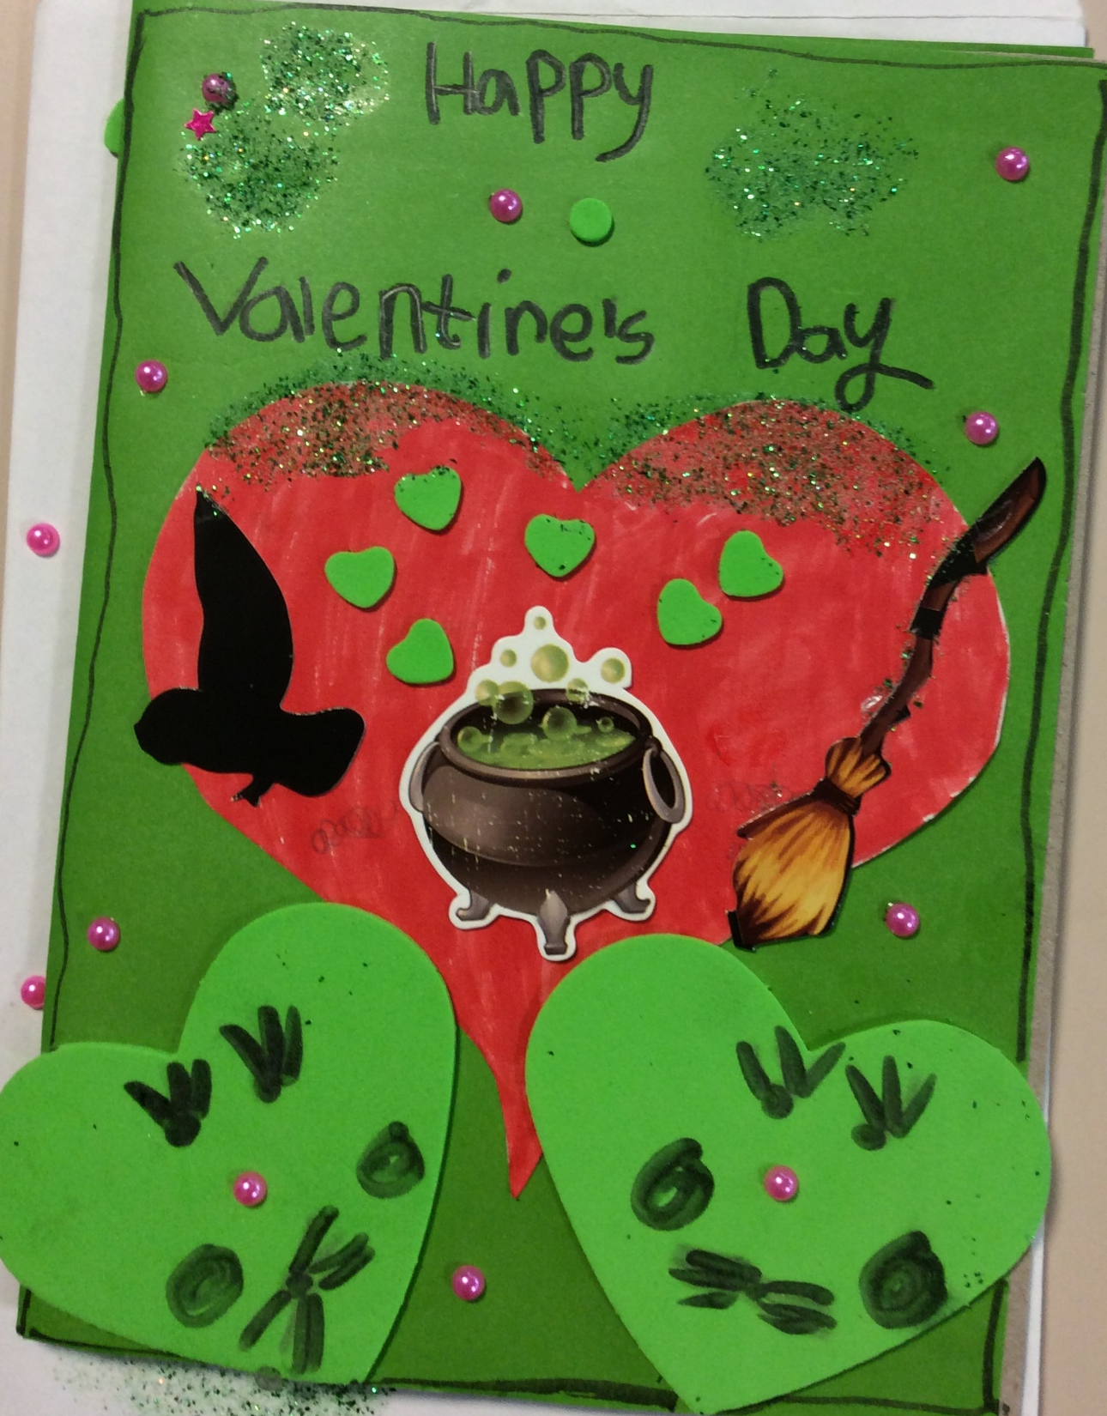
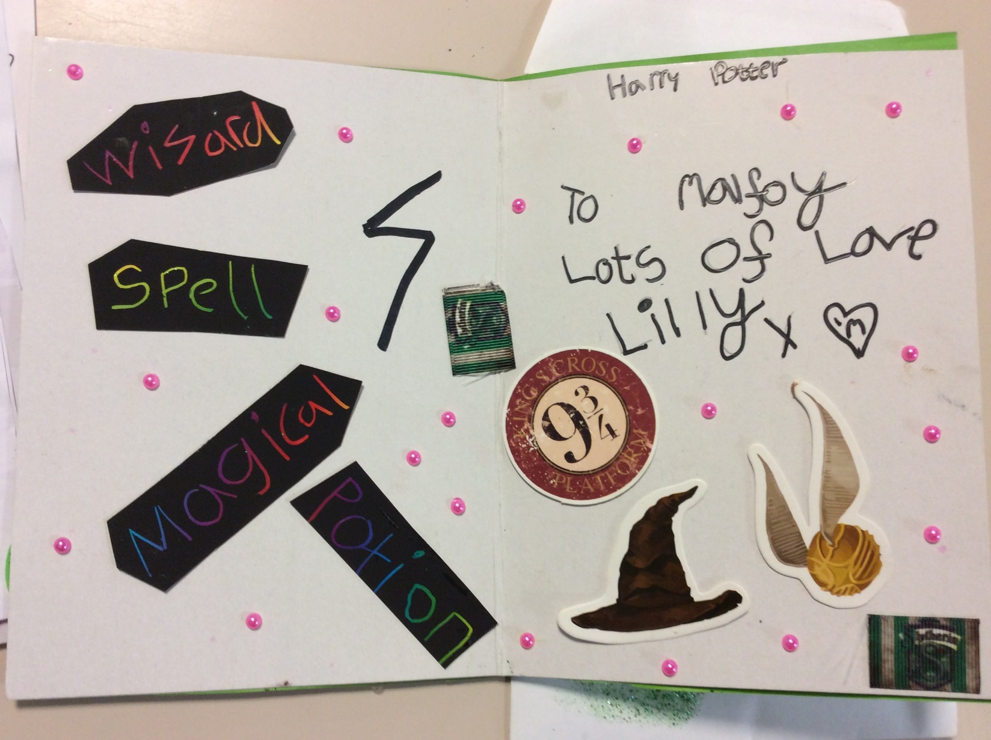
EYFS/KS1 winner
Lily Harrison, Ash Class

Slide 17
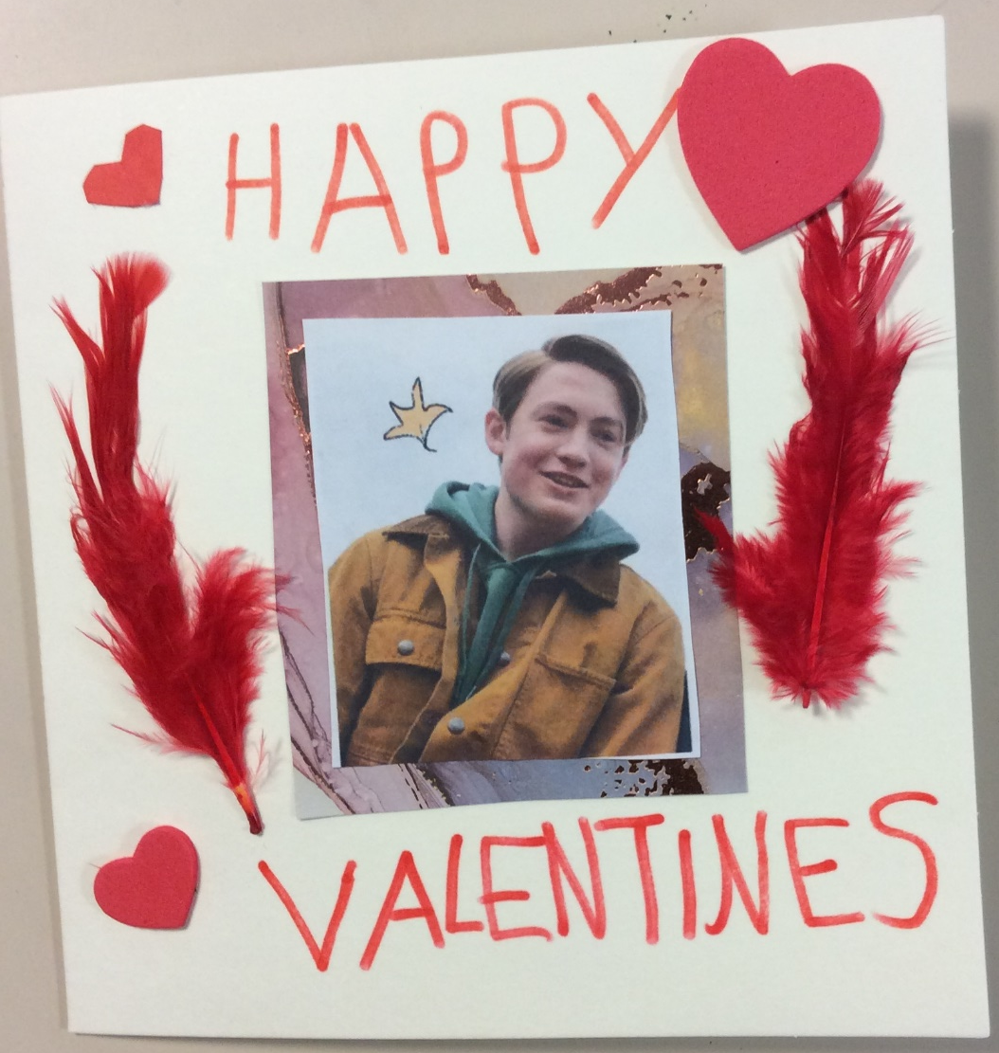
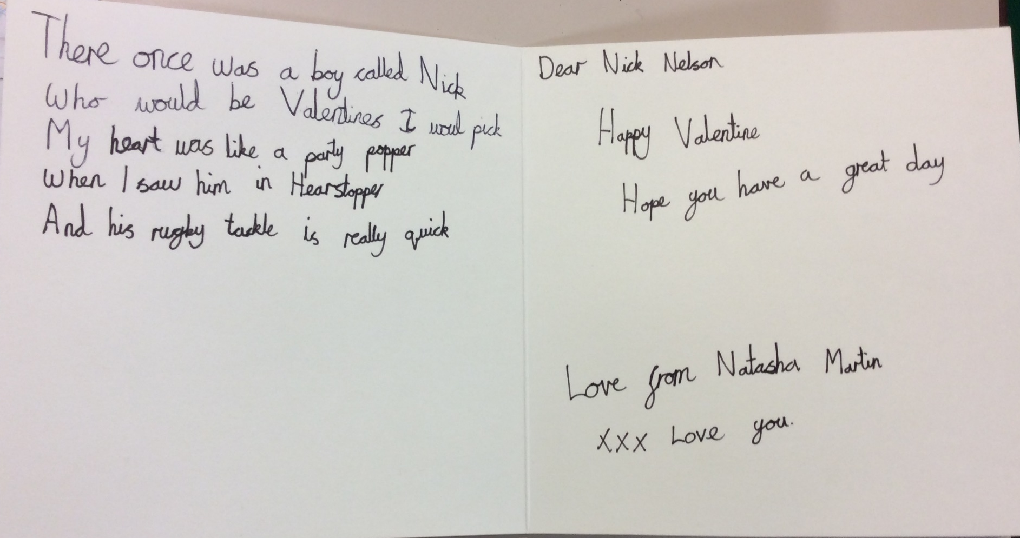
Natasha Martin, Hawthorn Class
KS2 winner

Slide 18
March
Reading for Pleasure Competition

Slide 19
Dress up as a Book Character

Slide 20
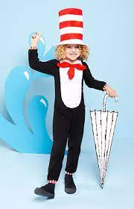
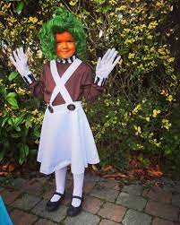
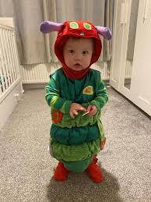
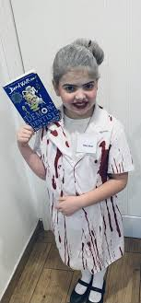
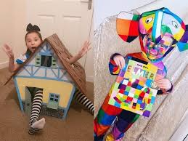
World Book Day = 7th March!

Slide 21
All entrants must be handed in to your class teacher with your name and class on the back.
Deadline = Thursday 21st March.
Winners announced in that Friday’s celebration assembly.

Slide 22
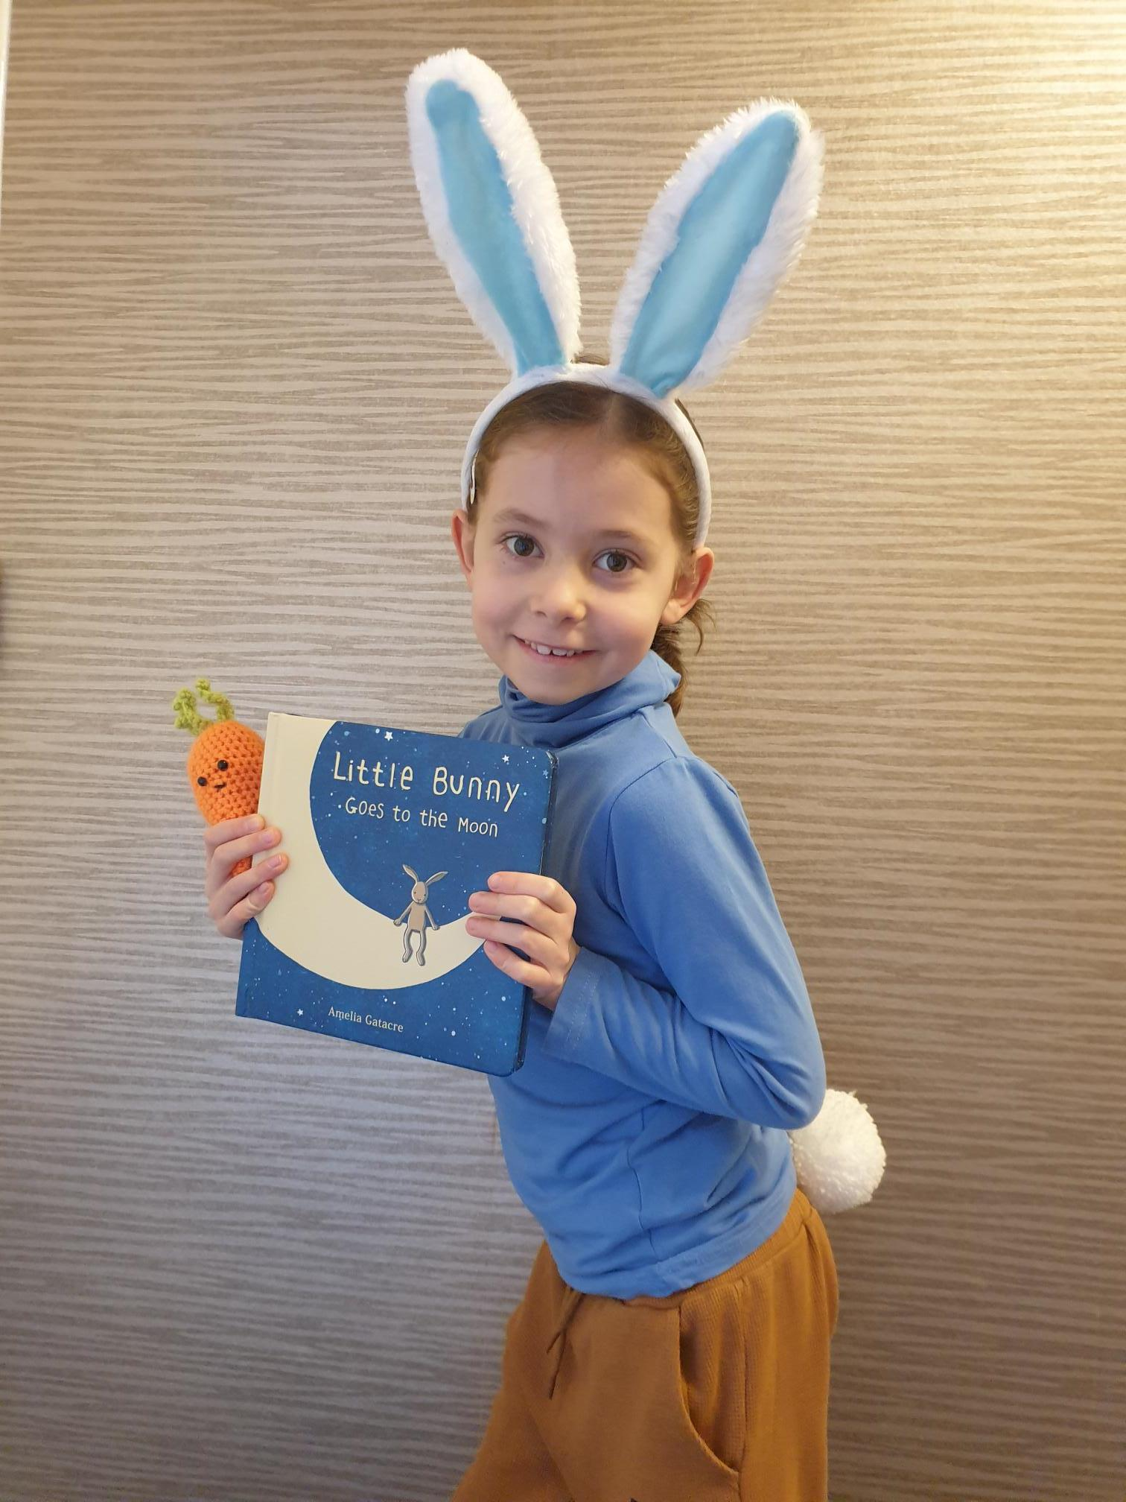
EYFS/KS1 runner up
Emma Sorrie, Willow Class

Slide 23
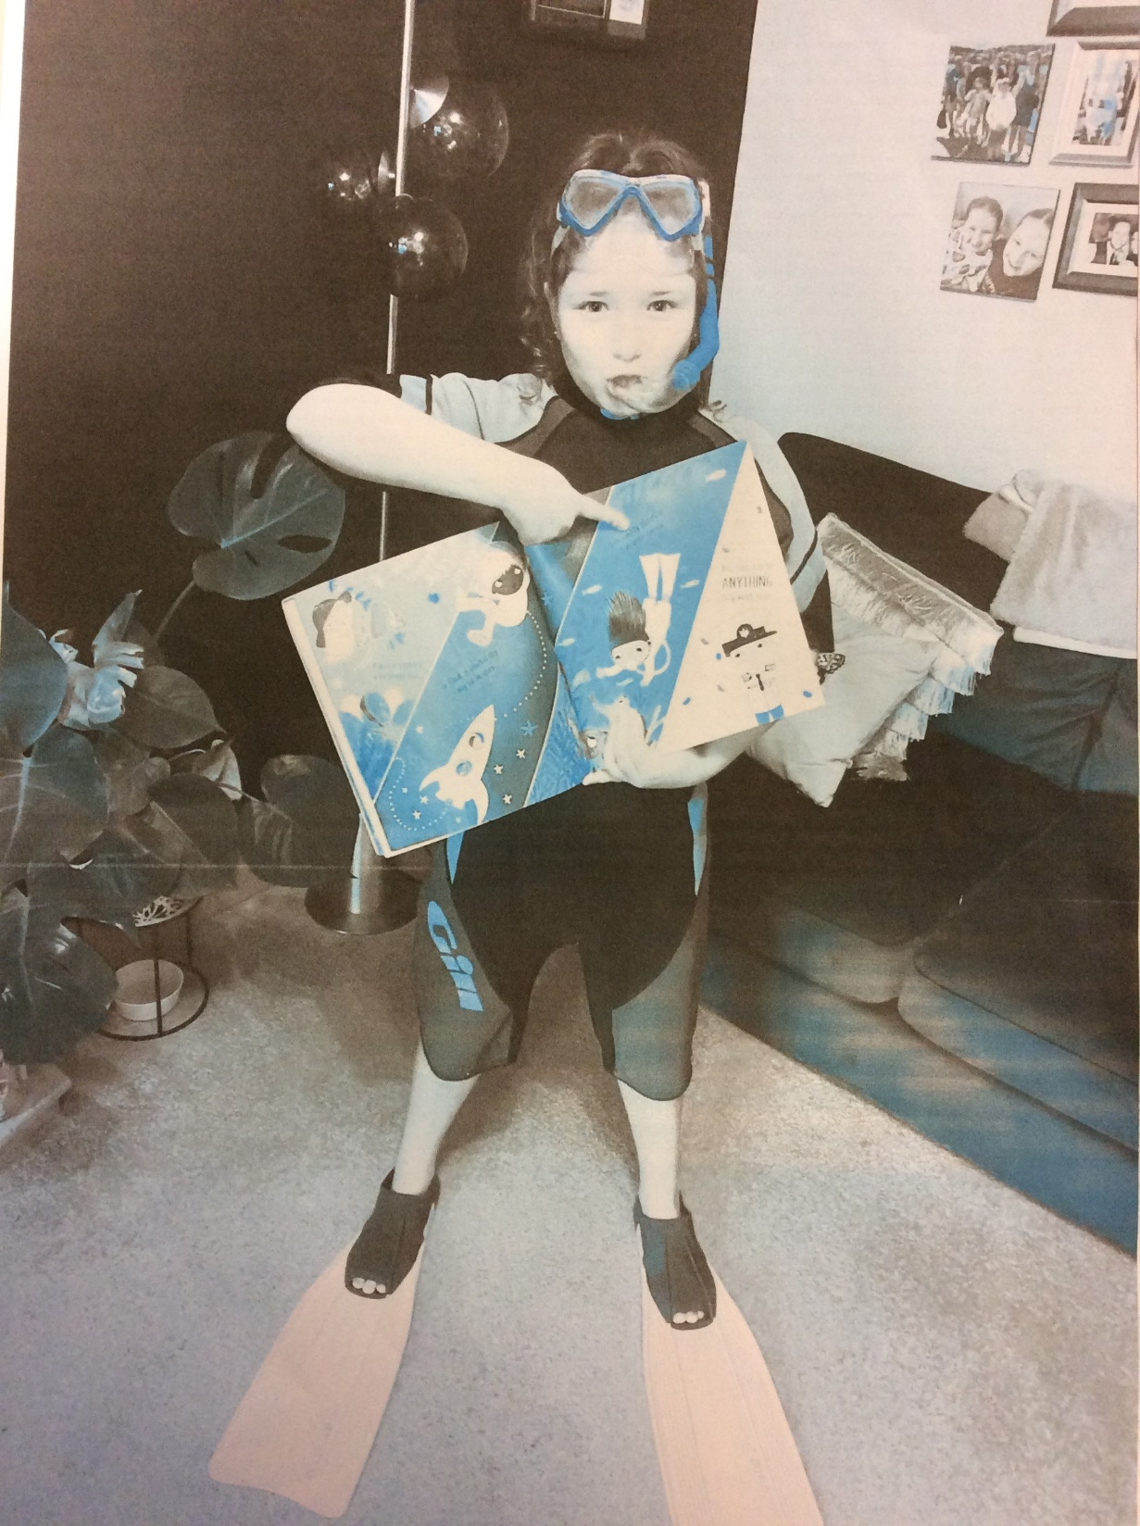
KS2 runner up
Poppy Foord, Beech Class

Slide 24

EYFS/KS1 winner
Meredith Clarke, Willow Class

Slide 25
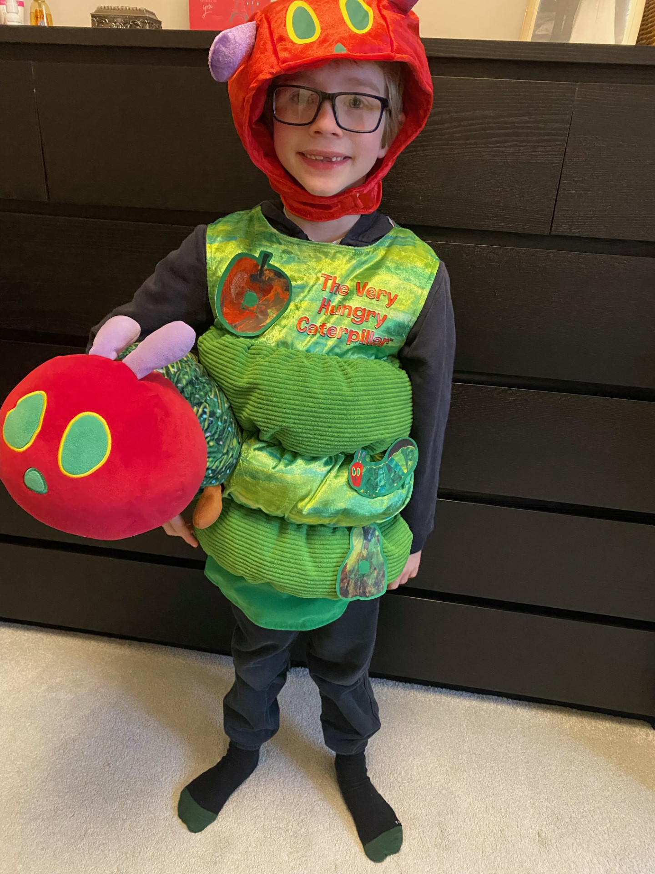
KS2 winner
Sebastian Lister, Beech Class

